Slide 1
Scoring Setup
All levels of Scorer by Paul Airey, Dany DeBakker, Ulf Langrock and Hannu Rintanen

Slide 2
1. Setup Scoring Software
LION SCORING SOFTWARE

Slide 3
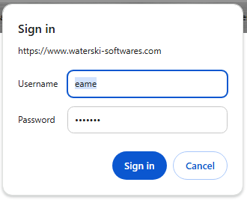
Prepare Setup
Start with Lion SCORING SOFTWARE If installed to your computer, just open software.
Waterski Software – both Homologation & Scoring software
License:
All federations and officials of IWWF are licensed to use the "Waterski Scoring" software.
Needed configuration:
Any computer with Windows 7, 8, 8.1, 10, 11.
The software can work on a Windows installed virtual machine on a Mac or Linux.
Waterski Scoring Full 2025 click “download”
Pop-Up screen – asking credentials:
Username: eame Password: scoring

Slide 4
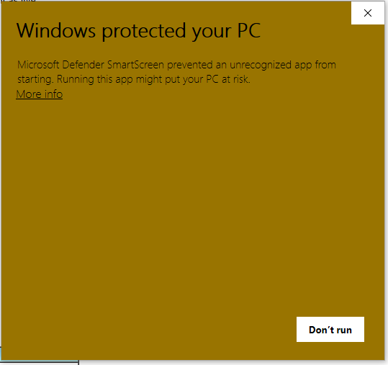
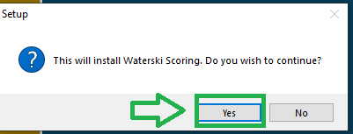
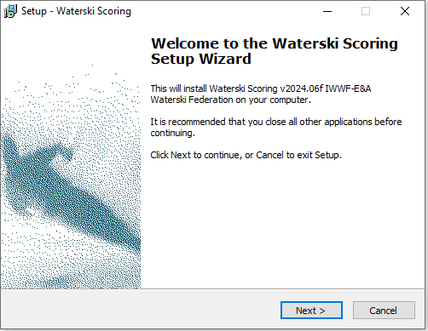
Prepare Setup
Pop-up screen is asking / ask to verify software installation: click Yes
Pop-up screen: click more info
click Run anyway
Pop-up screen is asking / ask to verify software installation: click Next

Slide 5
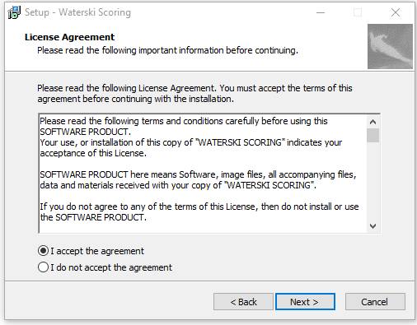
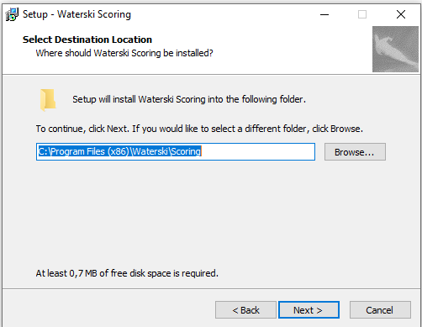
Prepare Setup
Select where you want to install software (Browse if you want a different destination)
click Next
Select: I accept the agreement
Click Next

Slide 6
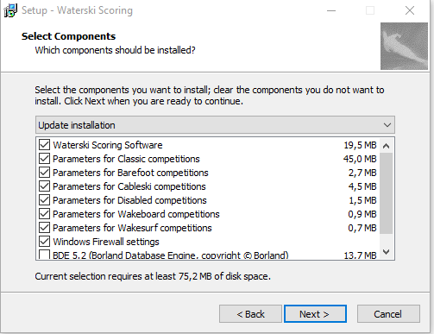
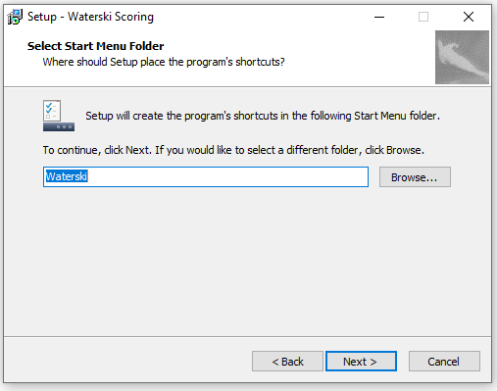
Prepare Setup
Select: All
Leave IDE 5.2 empty, if you have already software installed to computer.
Click Next
Select where you want to install Start Menu Folder (Browse if you want different destination)
click Next

Slide 7
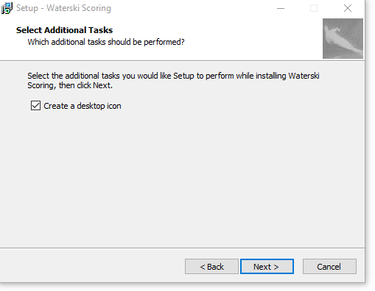
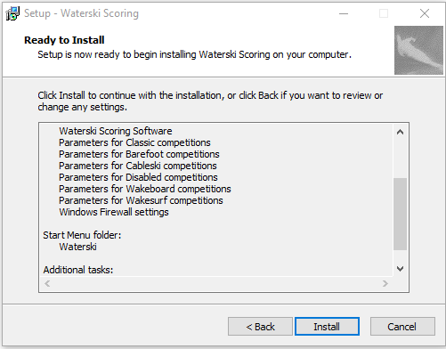
Prepare Setup
See all parameters selected before installation
click Install
Select: Create a desktop icon (if you want)
Click Next

Slide 8
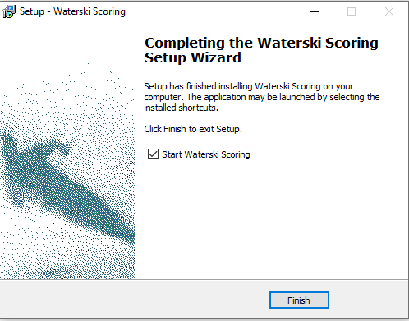
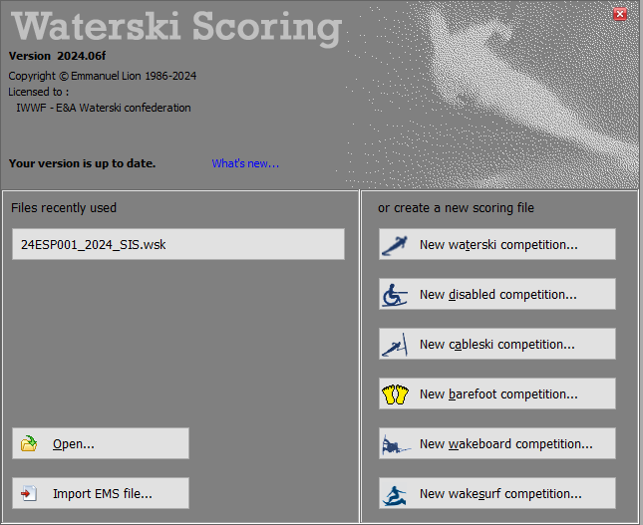
Prepare Setup
You can check software last updates by clicking here.
Tick: ”Start Waterski Scoring”
Click Finish
Software is ready to use
Time to check the data from IWWF EMS

Slide 9
2. IWWF EMS
PREPARE DATA IMPORT TO SCORING SOFTWARE

Slide 10
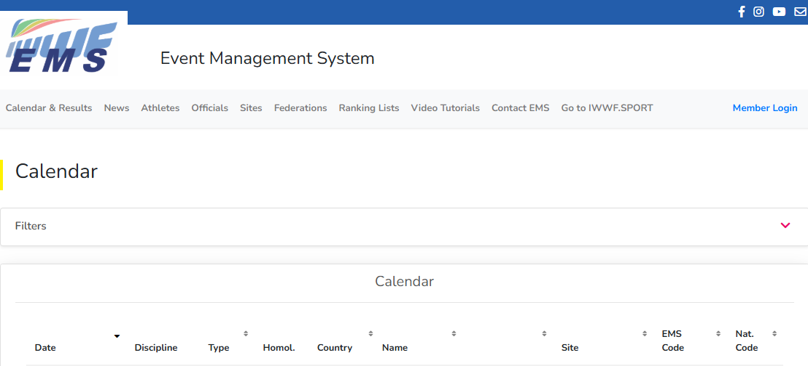
IWWF EMS (Event Management System)
Login - click: Member Login

Slide 11
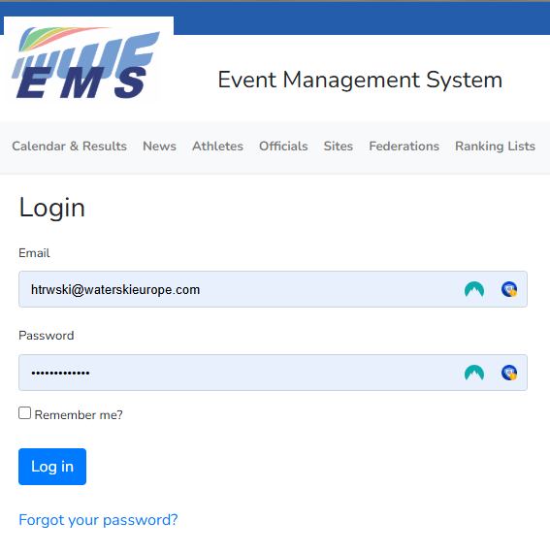
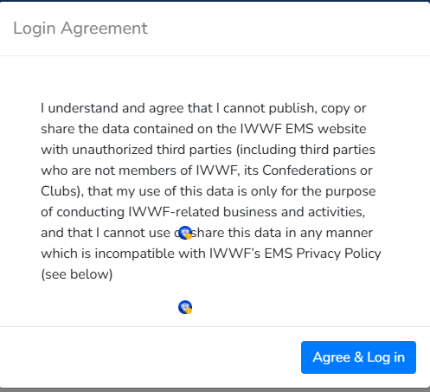
IWWF EMS (Event Management System)
Login with registered credentials
Your Email Address
Your Password
Tick Remember Me ?
Click Log in
Tick this too
Click Agree & Log in

Slide 12
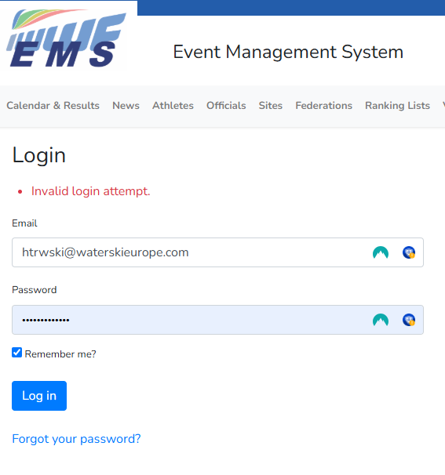
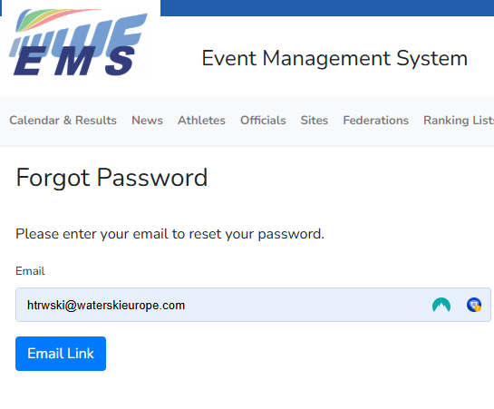
IWWF EMS (Event Management System)
Invalid login attempt
a) Use a different Email and/or Password
b) Forgot Your Password ?
Click ‘Email Link’ to update your login password
Error message !!!

Slide 13
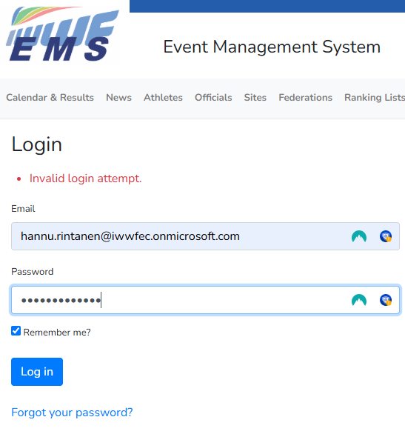
IWWF EMS (Event Management System)
Use correct email & pw
Click: Agree & Log in

Slide 14
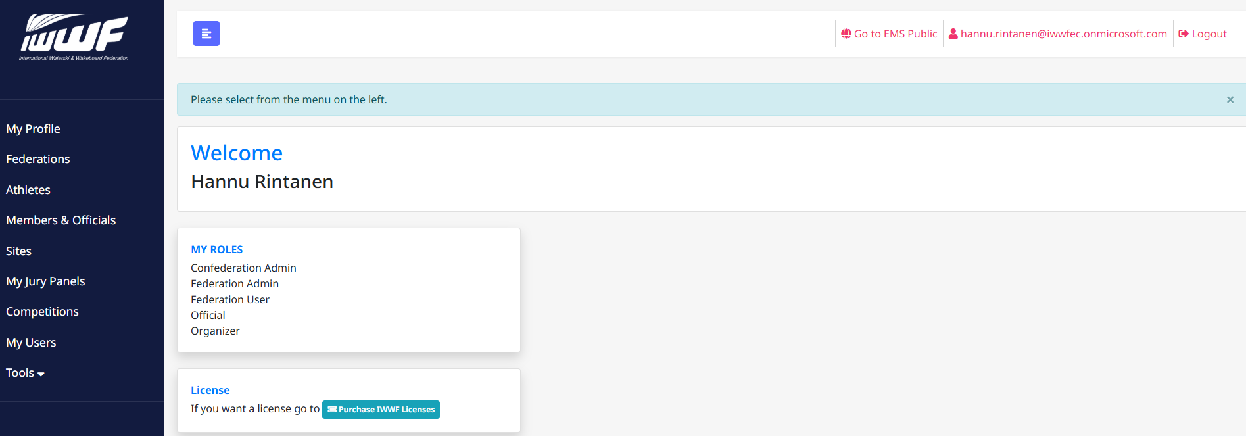
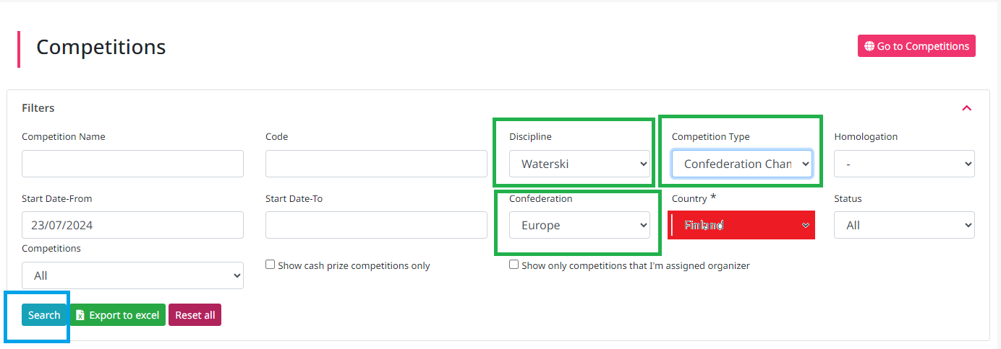
IWWF EMS (Event Management System)
Click either ”My Jury Panels” or ”Competitions”
Click FILTERS
Leave empty

Slide 15
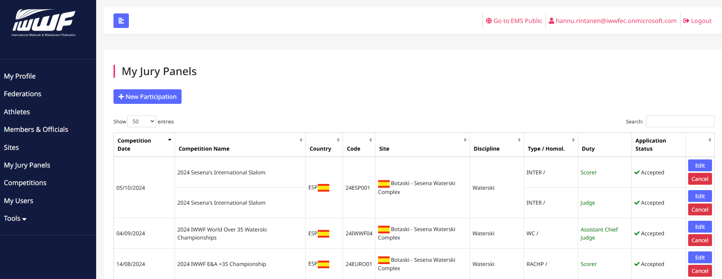
IWWF EMS (Event Management System)
Click Name of Competition to see details

Slide 16
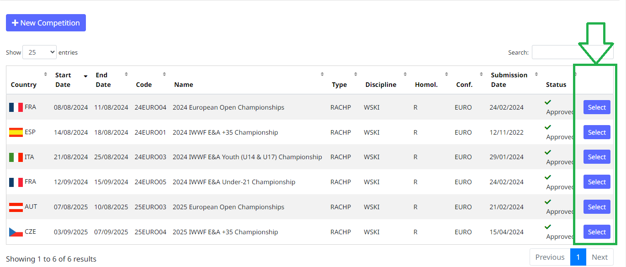
IWWF EMS (Event Management System)
Competitions
Click Name of Competition to see details
Click SELECT to go into competition data

Slide 17
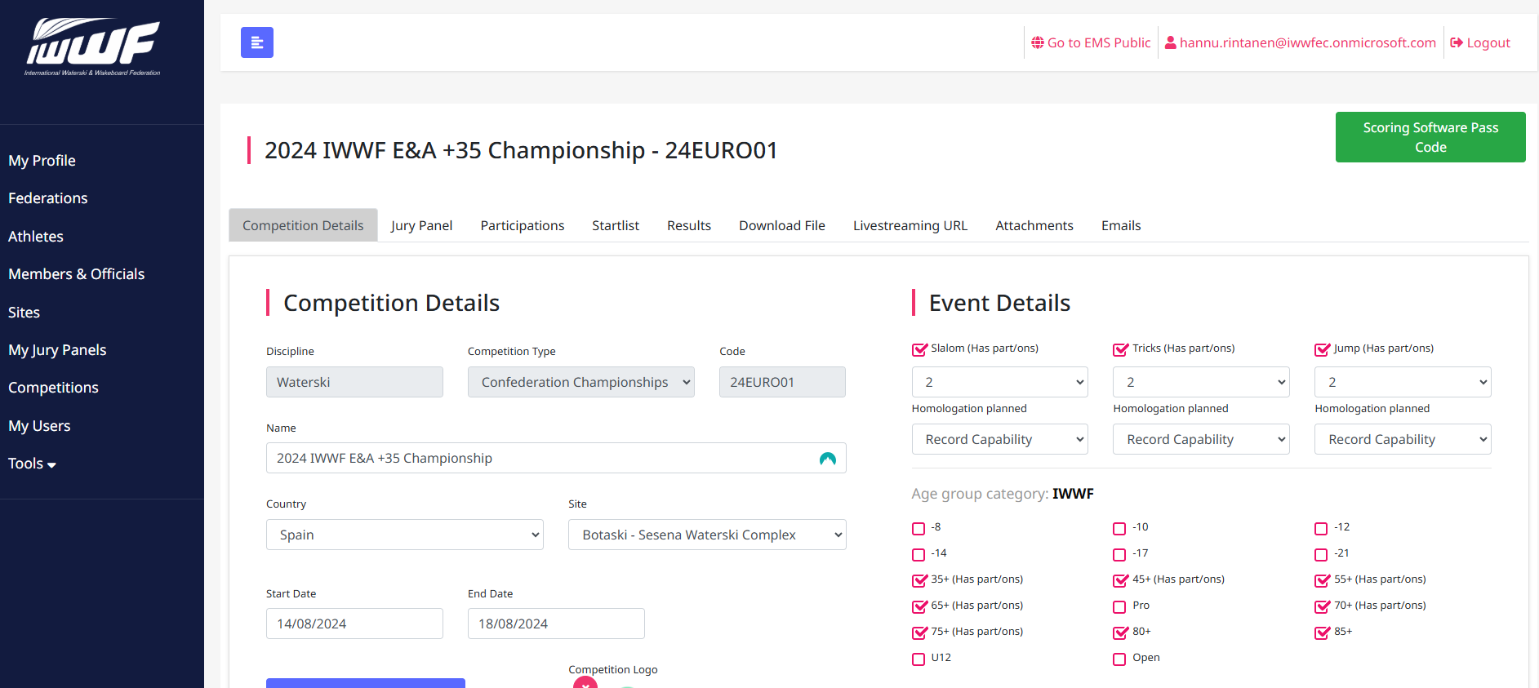
IWWF EMS (Event Management System)
Example: 2024 IWWF E&A Over 35 Championships
Check Competition Details
All Bulletins are published / shared via EMS
Deadlines published
Contact details published

Slide 18
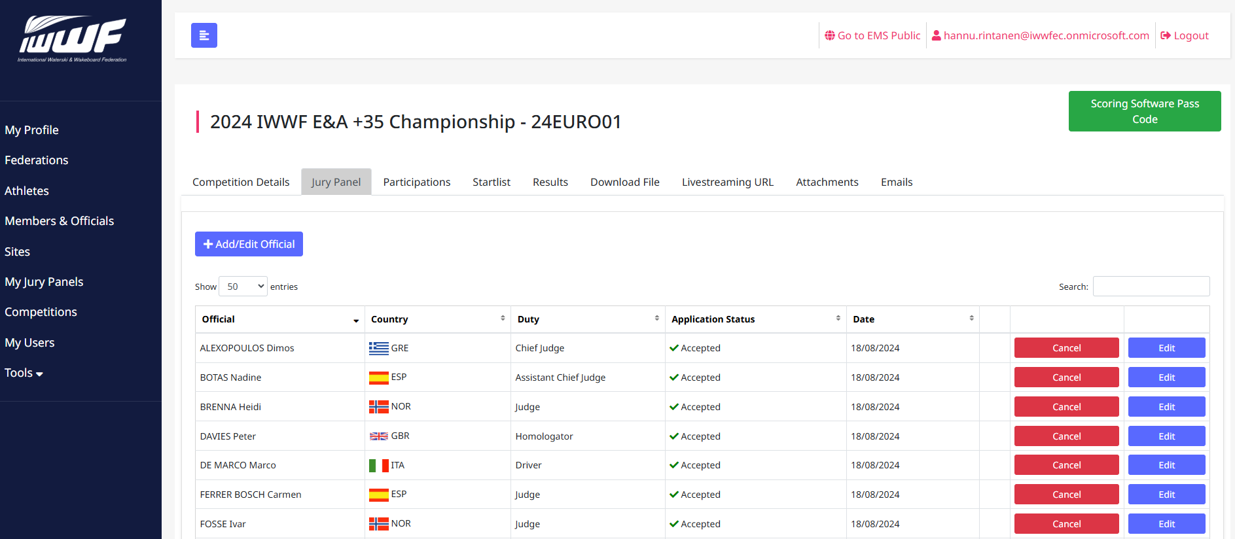
IWWF EMS (Event Management System)
Check JURY PANEL – all appointed Officials If an Official is added in the Scoring Software, you will need to add them manually here too; otherwise, the competition file upload will not work. If you can’t find an Official in EMS, do not add them to the Scoring Software; the upload will not work.

Slide 19
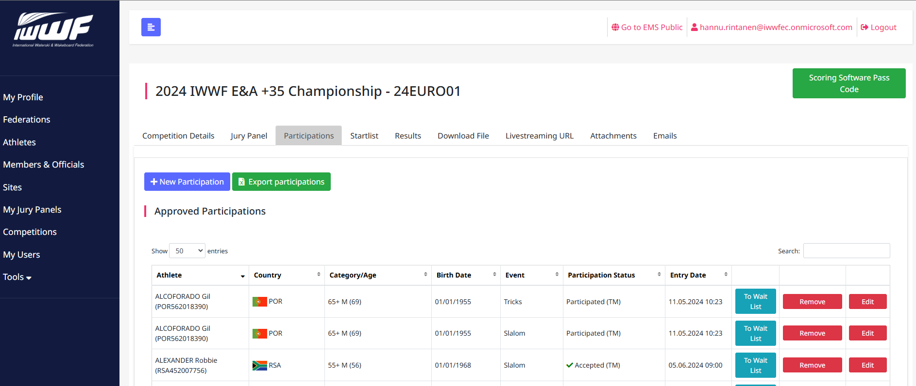
IWWF EMS (Event Management System)
Check PARTICIPATIONS Just a quick check before you download the competition file for the Scoring Software. You can download all participations as an EXCEL-sheet.

Slide 20
IWWF EMS (Event Management System)
Download File for Scoring (*.xml)

Slide 21
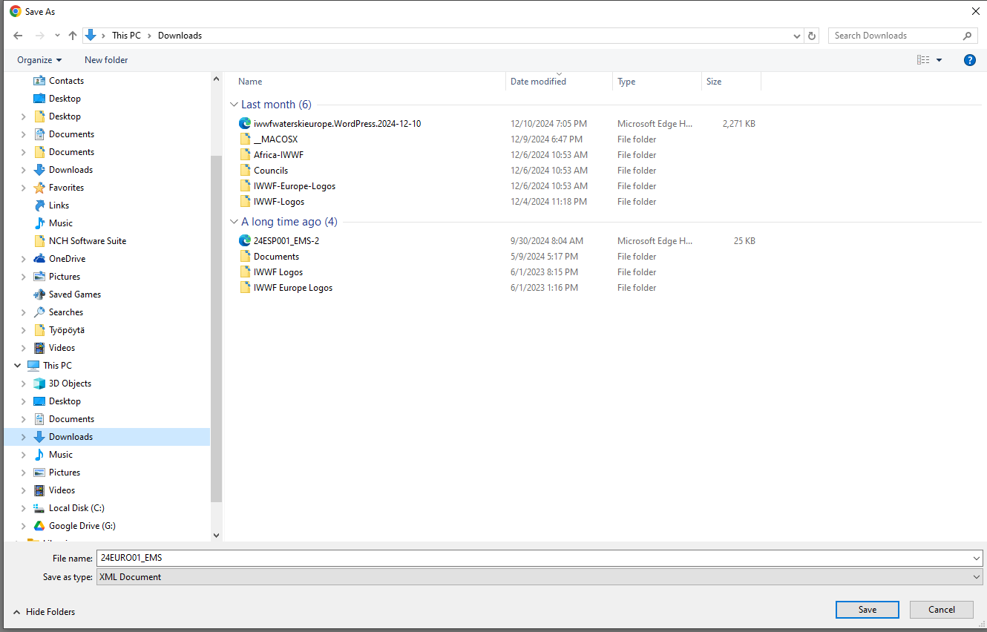
IWWF EMS (Event Management System)
After saving file, go back to Scoring Software
Continue work there
Come back to EMS, when you have Start List ready for publish.
DOWNLOAD FILE Click DOWNLOAD FILE Remember where you download your competition xml-file. In example, it is named 24EURO01_EMS.XML

Slide 22
3. SCORING SOFTWARE
DATA IMPORT TO SCORING SOFTWARE AND WORK WITH IT

Slide 23
Waterski Scoring
Import EMS file (just saved in previous step)
Continue work here
SCORING SOFTWARE Software can be found from Waterski softwares (waterski-softwares.com) When opening, remember to check if there is an update available. Use “Check for Updates” when starting.

Slide 24
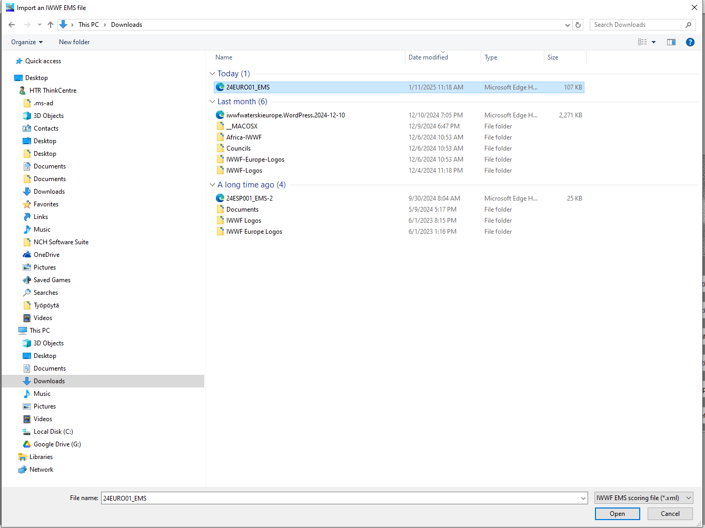
Waterski Scoring
Select correct *.xml-file
24EURO001_EMS.xml
Click OPEN

Slide 25
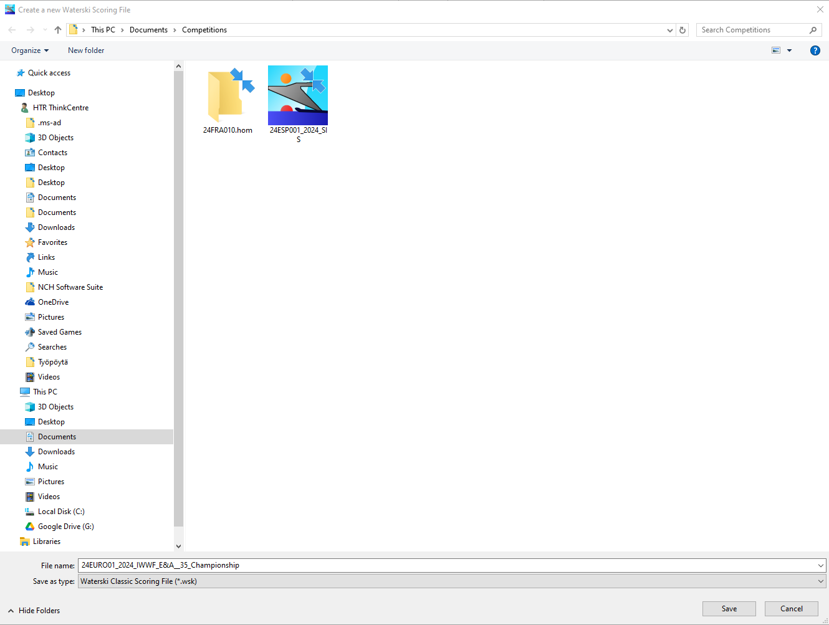
Waterski Scoring
Create a new Waterski Scoring File
For example:
24EURO001_2024_IWWF_E&A_35_Championships
Click SAVE
NOTE Do NOT save your scoring file to the ”cloud services”. Always save it either your computer Hard Drive (usually C:\ and/or External Drive (USB-stick, Hard drive, etc.) Please make a copy of file (at the end of every day)

Slide 26
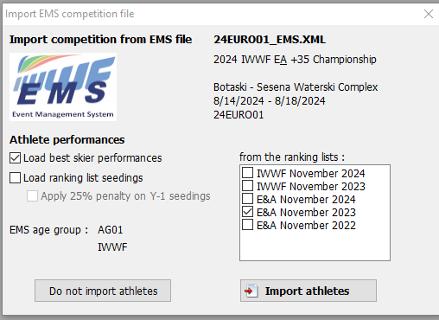
Waterski Scoring
Import competition from EMS File
Check all features
Athlete Performances - tick both ”Load…” options
- then tick also Apply 25%....
From the ranking lists - tick both E&A November options

Slide 27
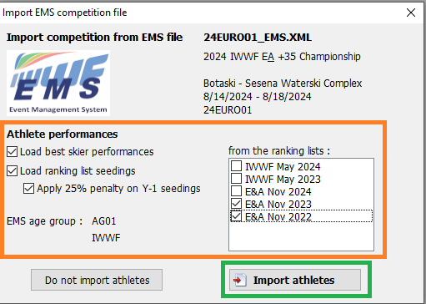
Waterski Scoring
Import competition from EMS File
Check all features
Athlete Performances - ticked both ”Load…” options
- ticked also Apply 25%....
From the ranking lists - tick both E&A November options (when E&A Titled event)
Click IMPORT ATHLETES

Slide 28
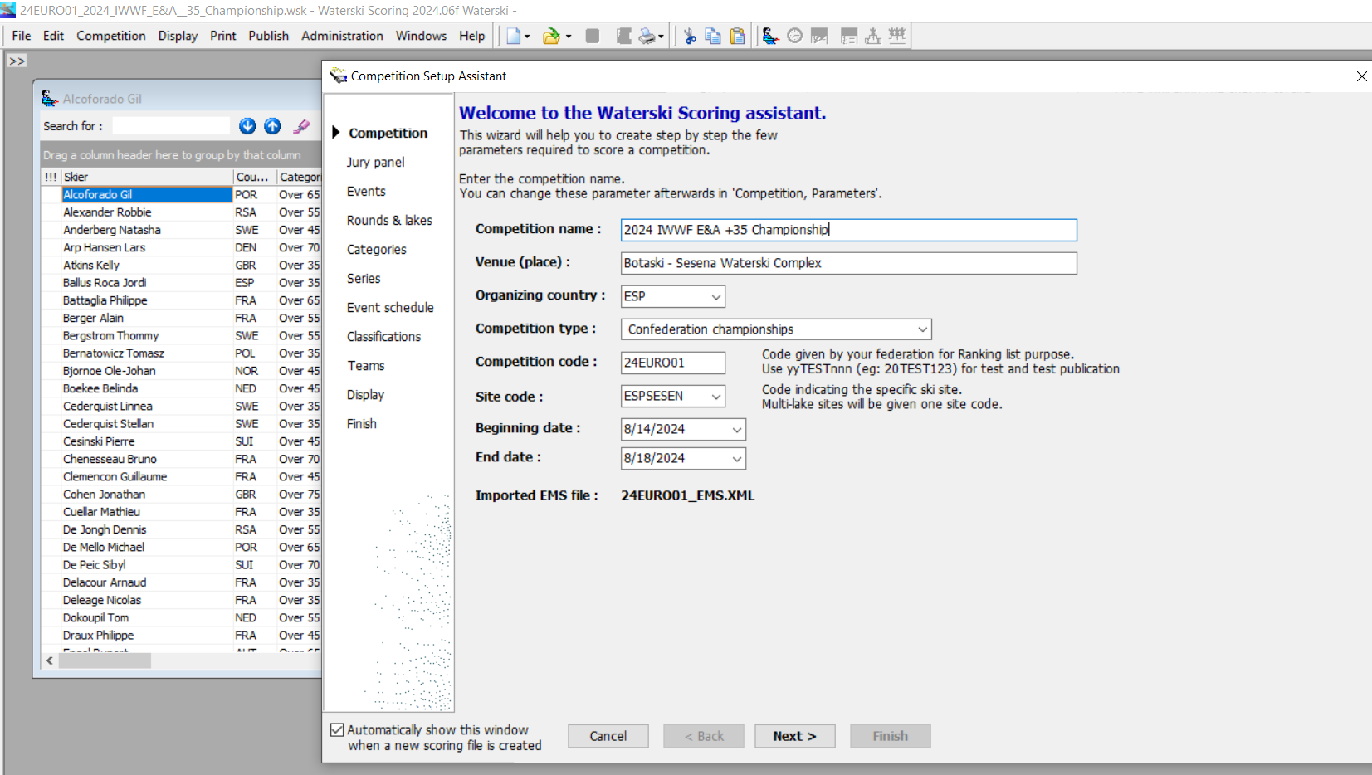
Waterski Scoring
Competition Setup Assistant
Check all features (pages)
Competition Jury Panel Events Rounds & Lakes Categories Series Event Schedule Classifications Teams Display => Finish
All data is imported from EMS.
Tick too

Slide 29
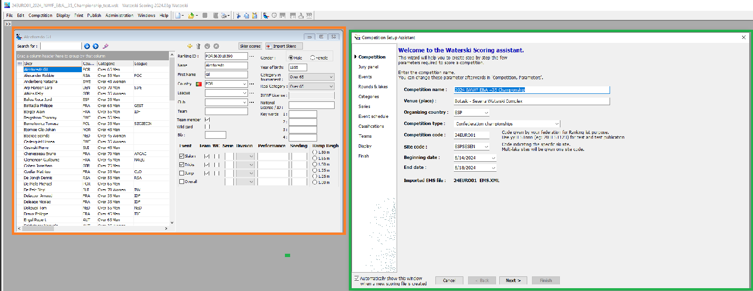
Waterski Scoring
A new window will open with the “List of Skiers” (as imported from EMS) and “Competition Setup Assistant”.
ADVICE:
It is a good idea to spend a little more time with Setup assistant of a competition.
It is so much easier to make changes etc. before any Starting Lists are made and published/posted.

Slide 30
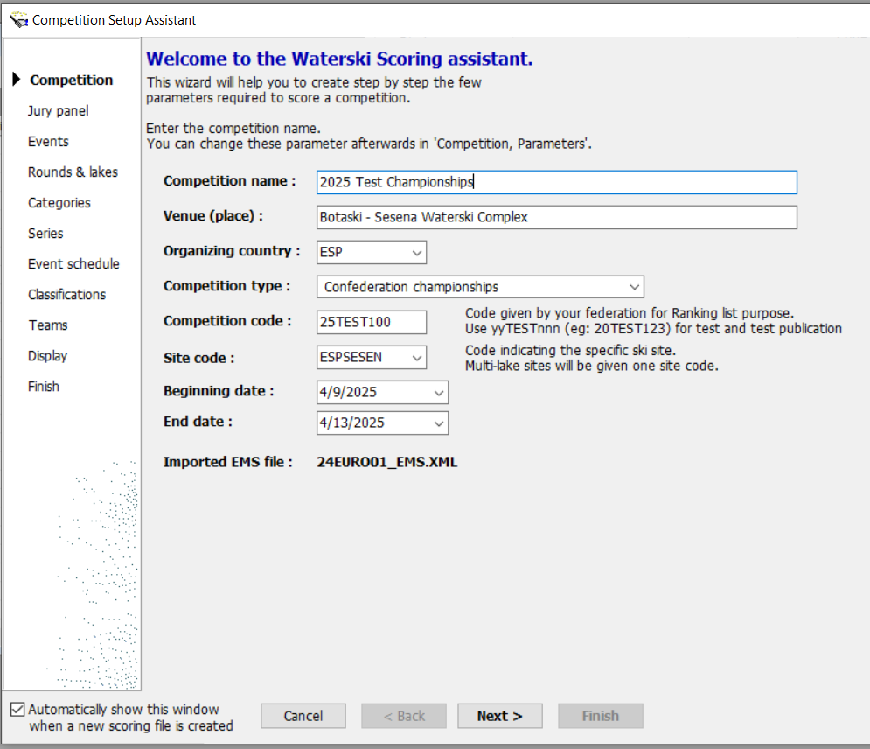
Waterski Scoring
Competition Setup Assistant
Changed
Competition name
Competition code
Beginning date
End date
Click NEXT
Check all columns and add Official Training Days to “Beginning date”.

Slide 31
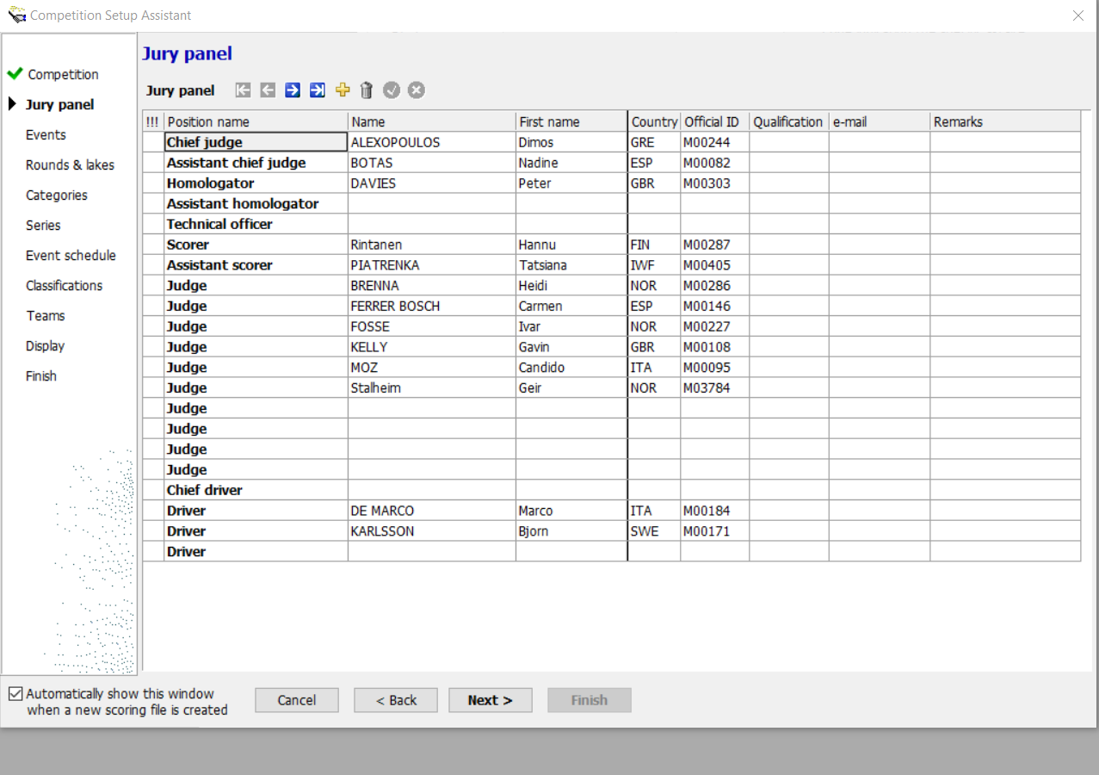
Waterski Scoring
Jury Panel
Check with EMS Panel details
Both system MUST have same Officials with correct details
NOTE: Technical Officer - do not add (if not found from EMS)
- EMS do not have such category added
All checks MUST done in EMS, and data must match for all Officials
Click NEXT
Check Officials’ ID & Qualifications and add them if empty field.

Slide 32
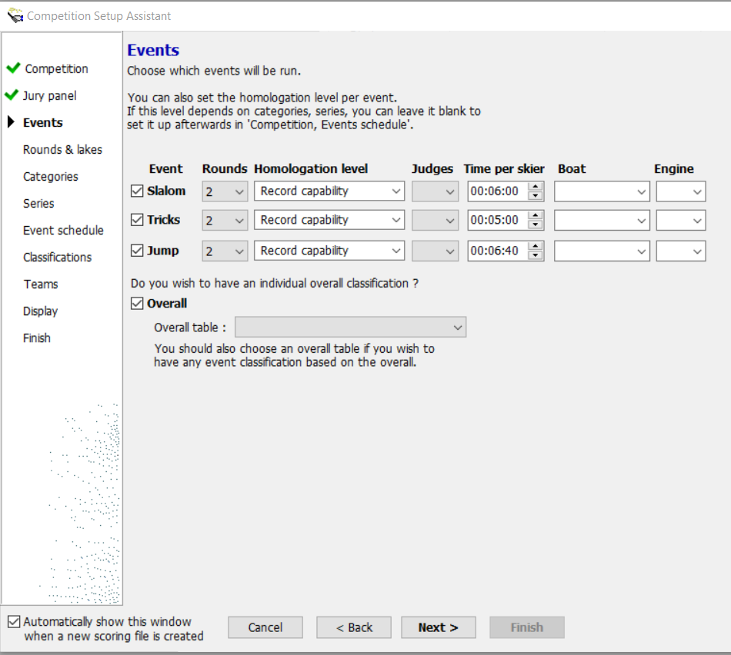
Waterski Scoring
Events
Check and fill all data
- Tick all events which will be held
- Input correct number of rounds
- Select Homologation Level per event
- Input number of Event Judges per event
- Time per Skier – just an estimation
- Boat must be select
- Boat engine size must be select
- If Overall is held, tick it too
- Select correct Overall table to be used
Click NEXT
Event: Tick All
Rounds: 2
Homologation level: Record Capability
Judges (in Event): - Slalom 3,4 or 5 (site setup; check with Chief Judge / Homologator
- Tricks 3 or 5 (with or without eyeTrick)
- Jumping: 3,4 or 5 (site setup; check with Chief Judge / Homolgator
Overall: select correct table to be used (2024 E&A 1000 points)

Slide 33
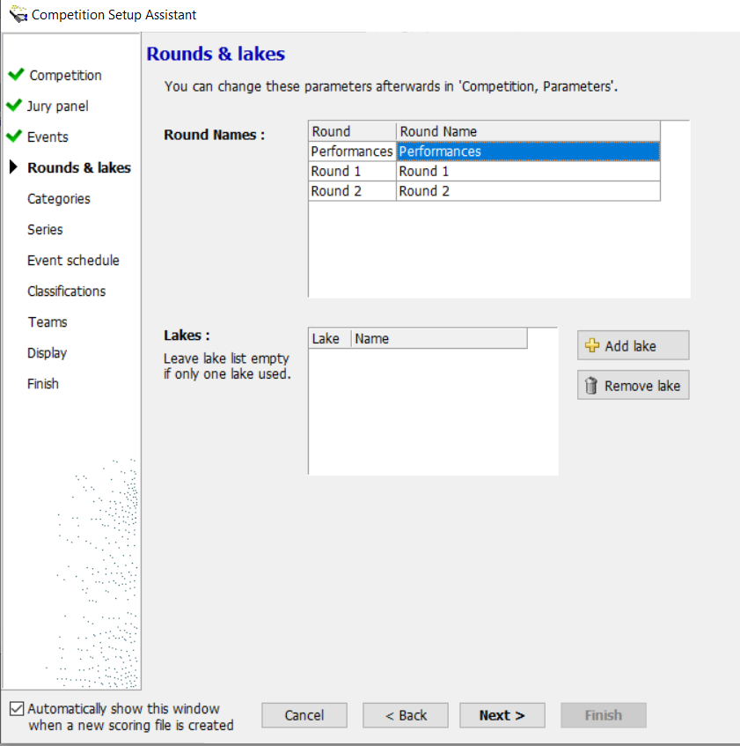
Waterski Scoring
Rounds & Lakes
Check and fill all data
Round 1 -> Preliminary Round Round 2 -> Final Round
Multilake use vs. Sure-Path Check with James T.
Sure-Path will use Lake 1, Lake 2 etc.. and not the Name you add.
Click NEXT

Slide 34
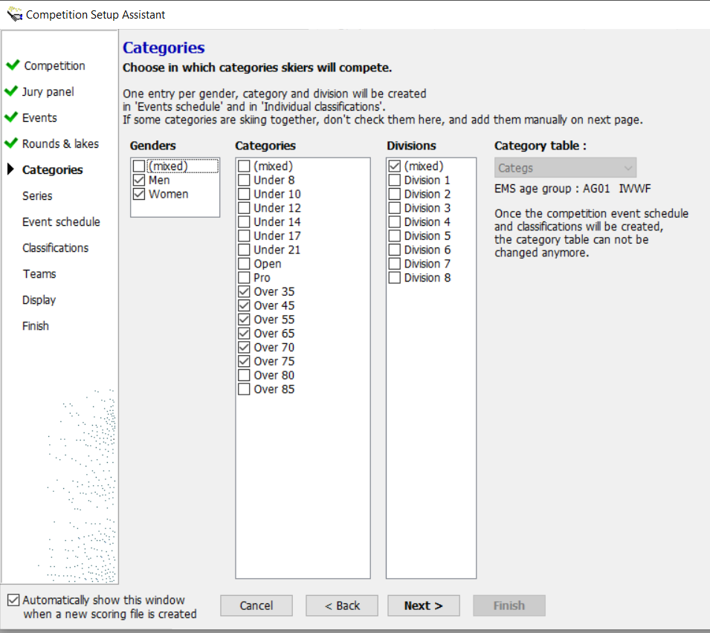
Waterski Scoring
Categories
Check and fill all data
Confirm with organiser and Chief Judge
Check that both Genders are selected.
Check that all Age Categories are selected (per Entry Forms, especially Over 35 Championships).
Click NEXT

Slide 35
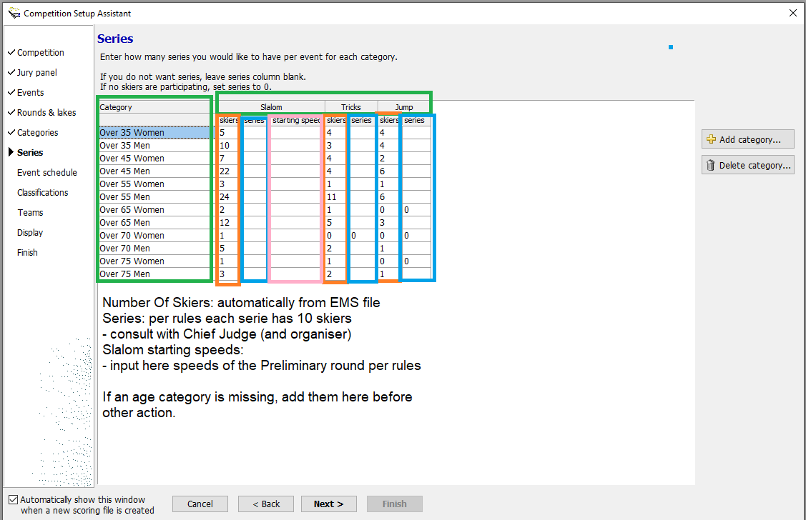
Waterski Scoring
Series
Check and fill all data
Add number of series (if more than 1)
Add Slalom Starting Speeds for Round 1
Add Category / Delete Category Confirm with organiser and Chief Judge
Click NEXT

Slide 36
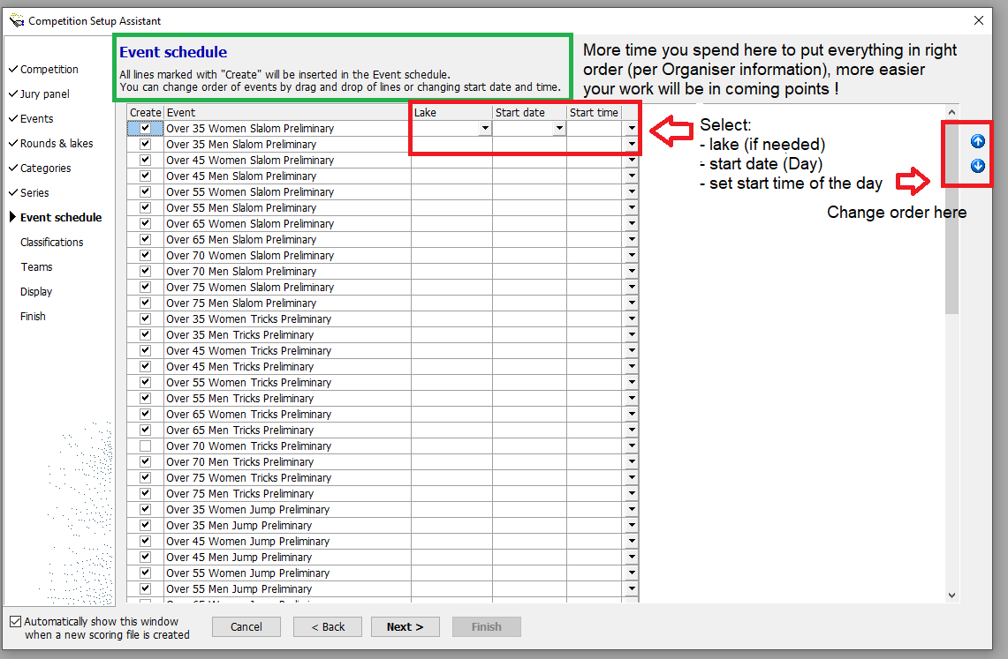
Waterski Scoring
Event Schedule
Now spend a little more time for “Event Schedule” setup.
Check and fill all data
This will take time, but do it once really well, then changes are easier to handle.
Confirm with organiser and Chief Judge
Click NEXT
Note: All can be done from ”Event Schedule” screen

Slide 37
Waterski Scoring
Event Schedule
Click NEXT
EXAMPLE OF COMPLETE SCHEDULE

Slide 38
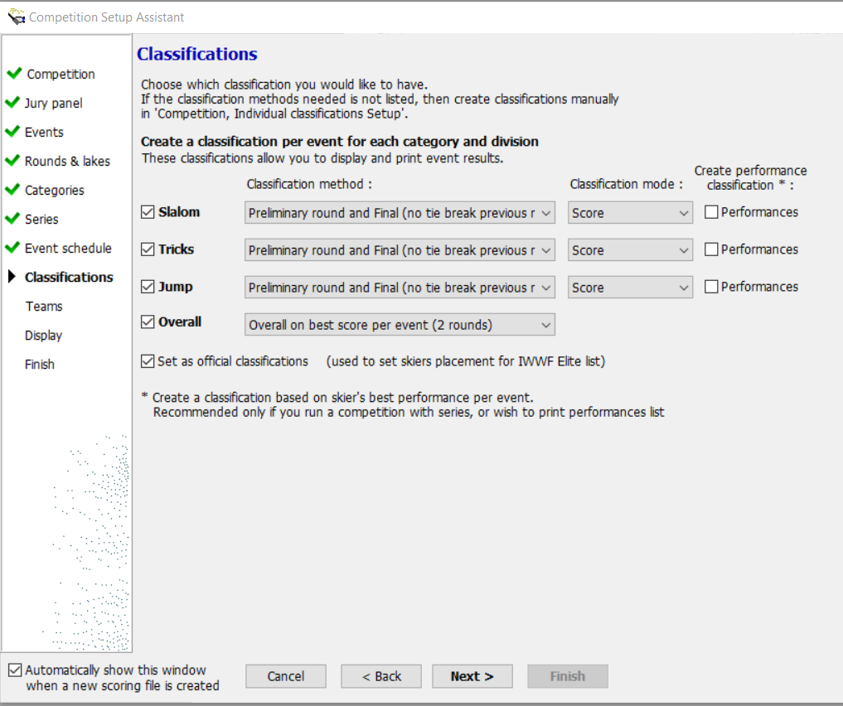
Waterski Scoring
Event Schedule
Check and fill all data
Please be sure that ”Classification Method” is correct
Create Performance Claissification: Tick them all Classification Mode is quite often ”Score”, but can be different
Confirm with Chief Judge
Click NEXT

Slide 39
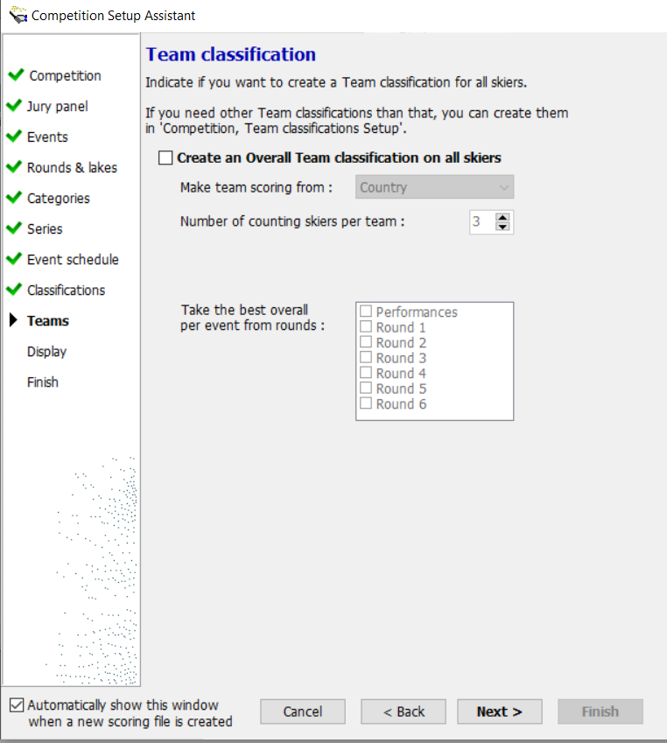
Waterski Scoring
Event Schedule
Check and fill all data
Tick ”Create an Overall Team classification” Select Team scoring from
No. Of counting skiers per team
Take the best overall score per event from rounds 1 & 2
Click NEXT

Slide 40
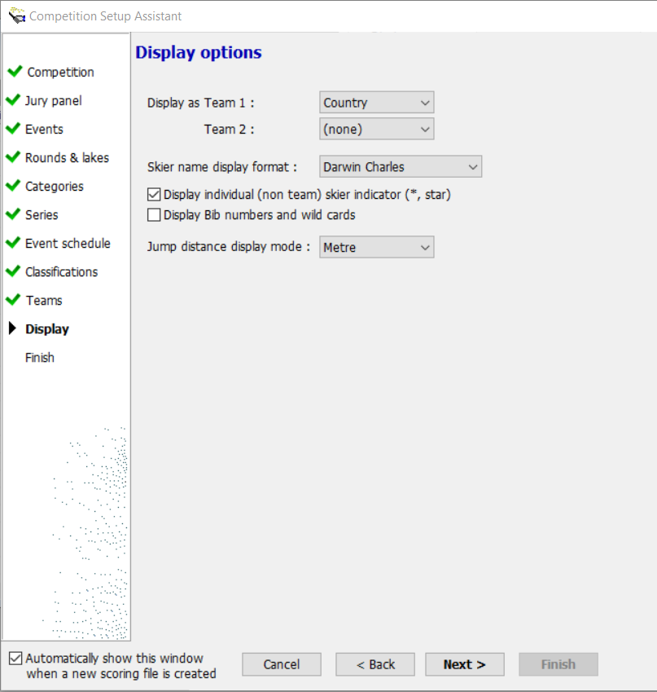
Waterski Scoring
Display Options
Check and fill all data
Display/select as Team 1 / Team 2
Skier name format
Display Individual (non-team skier)
Display Bib numbers and Wild Cards
Jump distance mode (only METRE in E&A is needed)
Click NEXT

Slide 41
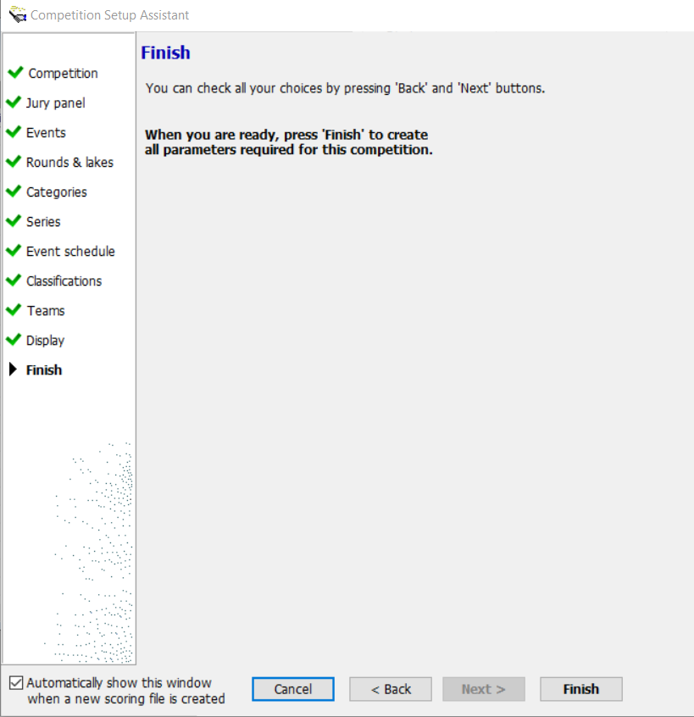
Waterski Scoring
Finish Setup
Time to check before ending setup.
Click FINISH

Slide 42
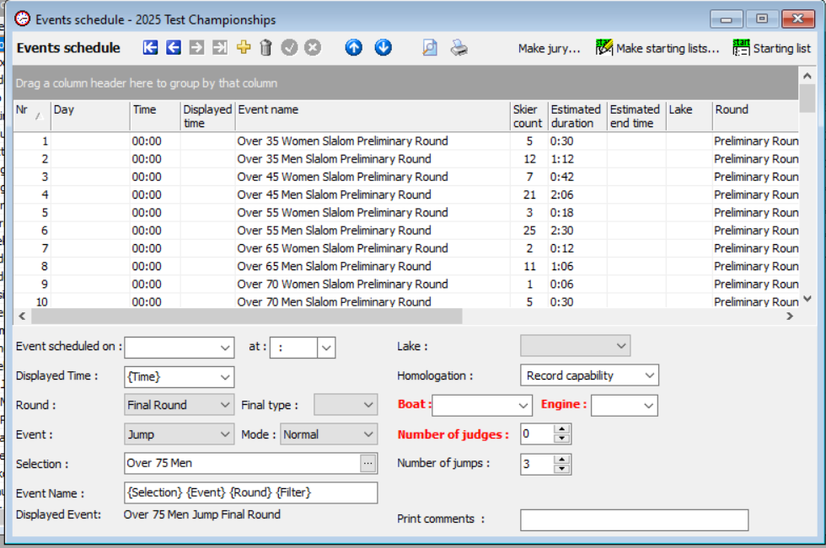
Waterski Scoring
Event Schedule
Take time to check before continuing.
Make adjustment(s) if needed
Make Starting Lists (per Rules)
Make Jury (from Chief Judge)

Slide 43
Waterski Scoring
Event Schedule
Time to check before continue.
1. Check that you have all series per event listed in schedule 2. Make adjustment(s) - Event schedule on (Day) - input Time at - Displayed time - put them to right order 3. Split Skiers to Series
4. Make Starting Lists (per Rules) 5. Publish Starting Lists (Round 1)
Next Make Jury (from Chief Judge)

Slide 44
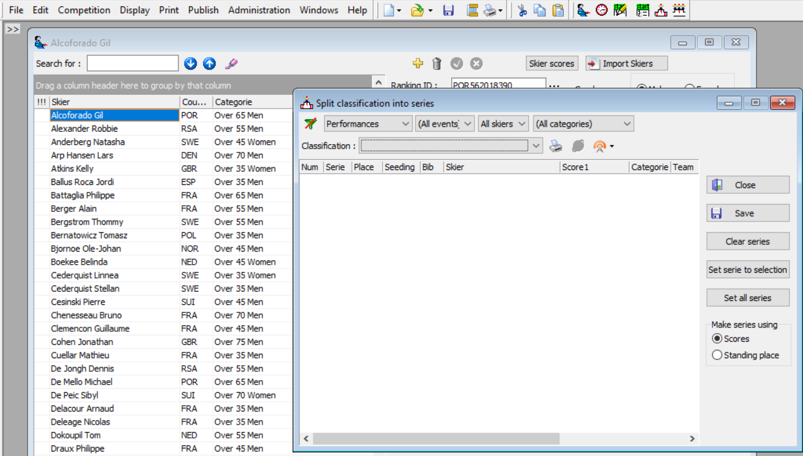
Waterski Scoring
Split Skiers in Series
Go to Competition and
select Split into Series

Slide 45
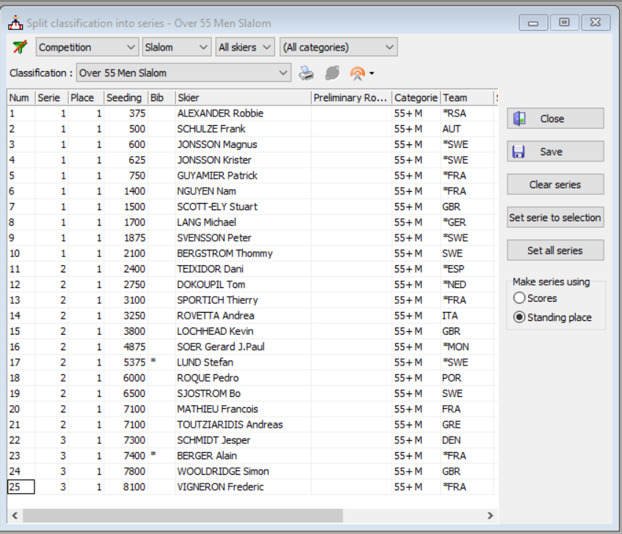
Waterski Scoring
Split Skiers in Series
Go to Competition and select Split into Series; then select:
Competition Slalom All Skiers All categories From Classification, select: Over 55 Men Slalom
Make series using ”Standing Place”
Set All series Input Number of skiers per serie: 10 (per IWWF Rules)
Click OK and Click SAVE

Slide 46
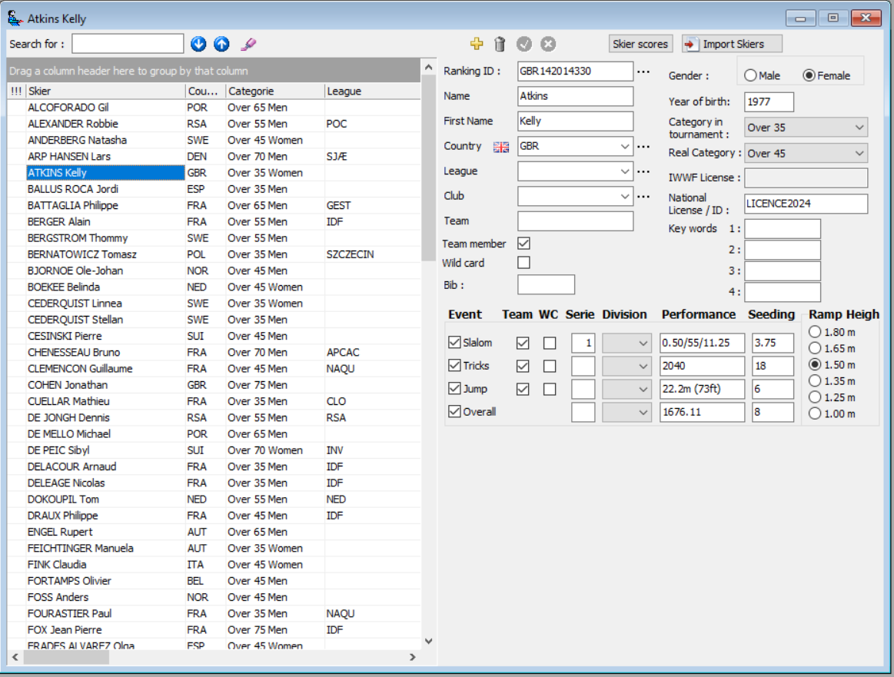
Waterski Scoring
Do NOT ONLY add a skier in the Scoring file. All skier data must be found in both EMS and Scoring file, hence check that a skier is registered in the EMS competition file.
Skiers Data Check vs. EMS
Ranking ID from EMS Name & Country from EMS Check Team member or not Wild card skier or not Individual classified are not WC Bib: input number if in use Check YOB is correct Check Category in tournament Real category auto-fill per YOB Check license details are filled
Check: - Event per EF (EMS) - Team per EF (EMS) - Serie per Seeding - Performance - Correct Ramp Height!

Slide 47
Waterski Scoring
What Needs to Checking Before Create Starting Lists
Skiers qualified to compete as Individual Skiers
WSC publish lists every year and update it during the season - https://www.waterskieurope.eu
Time schedule, even a provisional is ready to publish
Time schedule, even a provisional schedule can be published - check with the organiser and Chief Judge
Make Starting Lists (per Rules) - Publish provisional starting lists min. 7 days before the start of the competition (1st day of competition skiing, not training) - Finalise starting lists after the deadline, 12 noon the day before the start of the competition
Make Jury (from Chief Judge) in Scoring file (mandatory since 2025) !
LINKS to useful website IWWF – https://iwwf.sport/
EMS - https://ems.iwwf.sport/
Rankings & Results - https://www.iwwfed-ea.org/ IWWF Europe – http://www.iwwf-ea.eu/iwwf-ea/waterski.nsf/xHome.xsp/
World Waterski Council http://www.iwsf.com Europe Waterski Council https://www.waterskieurope.eu

Slide 48
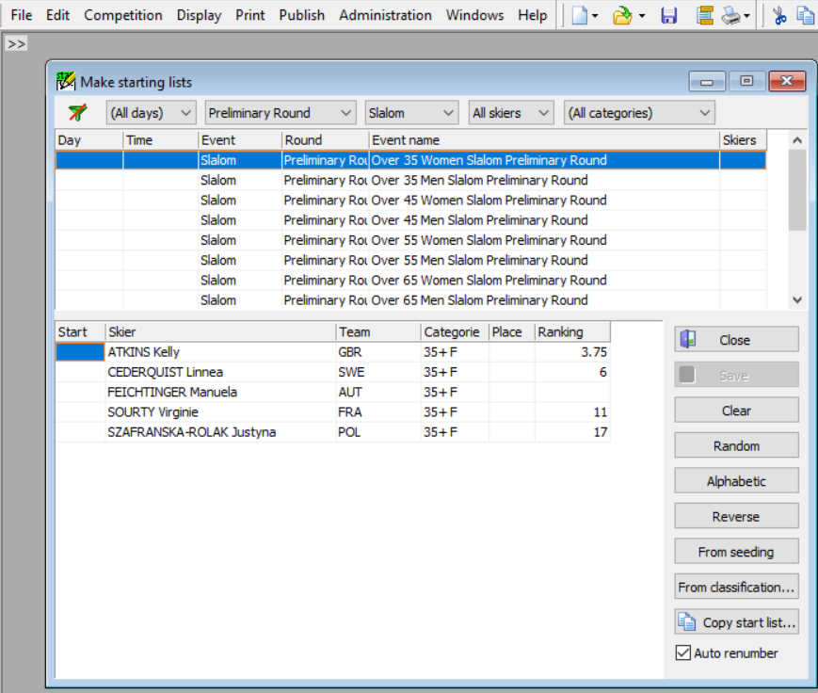
Waterski Scoring
Create Start Lists
Select ”Make starting list” from top menu
Choose Preliminary Round Choose Slalom Create Start List per Category
Select From seeding
Skiers in order as the highest seeded skier is the last skier in starting list
Save starting list
Continue through all categories, and continue the same way with Tricks and Jumping
Check correct RL

Slide 49
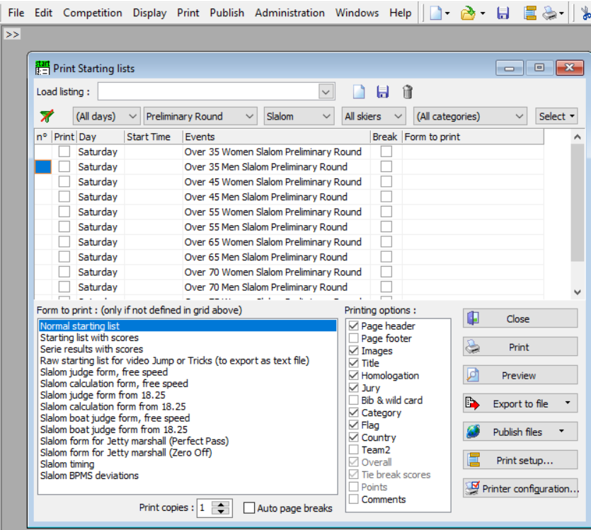
Waterski Scoring
Print Start Lists
Select ”Print and Starting list” from top menu
Choose Preliminary Round Slalom All skiers All categories Tick all Categories to print
Select Printing options and tick what to print Check ”Print setup”
Click Preview

Slide 50
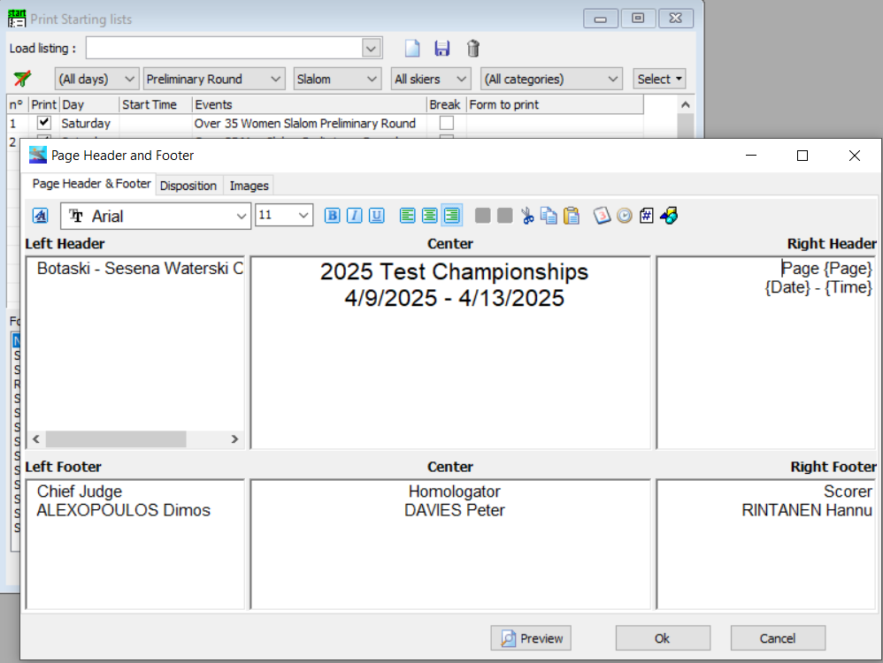
Waterski Scoring
Print Start Lists
Check ”Page Header & Footer” Make adjustments (if needed) what to print, font & size
Check ”Disposition”
Make adjustments (if needed) to Margins etc.
Check ”Images”
Make adjustments (if needed)
To pictures to be printed and position on paper

Slide 51
Waterski Scoring
Print Start Lists
Check ”Print setup” Select ”Print”
Select ”Printing options”
Click Preview

Slide 52
Waterski Scoring
Print Start Lists
Check ”Preview” Positions need to be adjusted if image & text overlaps.
Check print-out

Slide 53
Waterski Scoring
Print Start Lists
Check ”Print copies” – how many to print Tick ”Auto page breaks” or manually add ”Break” between series
Break aka. Add page break/change
Click ”Print”
Continue to print-out - Slalom judge form - Slalom calculation form - Slalom for Jetty (ZeroOff)

Slide 54
Waterski Scoring
Print Start Lists
Change to”Tricks” Forms to print - Normal Starting List (preview before printing) - Blank Tricks Judge form for 2 runs, or - Blank Tricks Judge form, 1 page per run
No Judge Forms needed with the use of eyeTrick
Select age categories to print, and print

Slide 55
Waterski Scoring
Print Start Lists
Change to ”Jump” Forms to print - Normal Starting List (preview before printing) - Jump form for meter readers or boat - Jump form for boat - Jump form for Jetty (ZO)
Select age categories to print, and print

Slide 56
Waterski Scoring – Publish of Competition webpage
Publish Competition Web page
(under ”Publish” top menu)
Check ”Competition name, code, dates, etc and update here Competition Rounds Lakes Display Classification points Interfaces

Slide 57
Waterski Scoring
Publish Competition Web page
(under ”Publish” top menu)
Check ”Competition name, code, dates, etc and update here Competition Rounds Lakes Display Classification Interfaces
When all data looks good, click OK
Updated missing Boat details & engine size

Slide 58
Waterski Scoring
Publish Competition Web page
(under ”Publish” top menu)
Check ”Competition name, code, dates, etc and update here Competition Rounds Lakes Display Classification points Interfaces Add logos and check their position Add links (IWWF, WSC, Wada,…) Fill your credentials for publising, and remember them.
Tick boxes and select file to be used
These files must be saved same place as Scoring file
Mandatory to tick
Publish

Slide 59
Waterski Scoring
Publish Competition Web page
(under ”Publish” top menu)
Publish complete
Check website https://www.iwwfed-ea.org/classic/competitions/2025
Left column Under ”Administration” click ”See test competitions”

Slide 60
Waterski Scoring
Publish Competition Web page
Check website https://www.iwwfed-ea.org/classic/competitions/2025
Time to check what has been published!

Slide 61
Thank You

