Slide 1

E
The 30th
E&A Waterski, Cableski and Disabled Officials seminar 2025
Hotel Stages
Prague, Czechia
11th to 13th April 2025

Slide 2

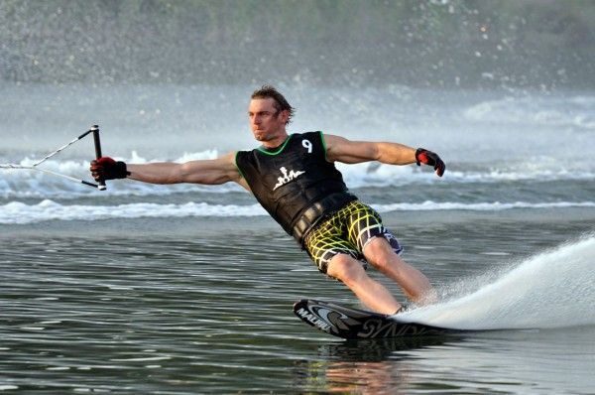
Thank you
Seminar 2026
We need a host for next year

Slide 3
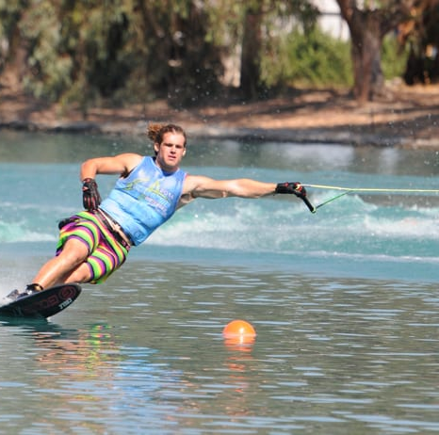
Thank you
THANK YOU
SEE YOU NEXT YEAR

Slide 4

E&A Waterski, Cableski and Disabled Officials seminar 2025
Please silence your cell phone
Sanction Fee: 10 € per call

Slide 5
E&A Waterski, Cableski and Disabled Officials seminar 2025
WELCOME
Lukas Horky President Czech Federation
Candido Moz – Chair Waterski Council
Dany De Bakker – Chair Disabled Council
Elena Kunert – Chair Cableski Council

Slide 6
E&A Waterski, Cableski and Disabled Officials seminar 2025
Waterski Council Members
Candido Moz – Chair Waterski Council
Amanda Scherer – Secretary
Stian Lilleberg – Treasurer
Aliaksandra Berazouskaya - Exams
Morten Froulund – Calendar /EMS
Hannu Rintanen – Website and Facebook Development
Dimos Alexopoulos – World Council Representative/Officials Records
Ricardo Botas – World Drivers Committee/Bulletins
Gavin Kelly – World Council Representative/Newsletters
Howard Ramsden – Africa Representative
Martin Kolman – Athlete Representative

Slide 7
E&A Waterski, Cableski and Disabled Officials seminar 2025
Cableski Council Members
Elena Kunert – Chair Cableski Council
Nicky Caine – Secretary & Treasurer
Joost DeLeijer
Ulf Langrock
Maoz Tal – World Council Representative
Nigel Talamo – Co-opted World Council Representative
Michael Mos - Co-opted
Jana Chatreen Meier – Athletes Representative

Slide 8
E&A Waterski, Cableski and Disabled Officials seminar 2025
Disabled Council Members
Dany De Bakker– Chair Disabled Council
Heidi Brenna – Secretary
Ivar Fosse - Treasurer
Paul Airey – World Council Representative
Carmen Ferrer
Dario Rossi
Philippe Turchet
Christophe Fasel – Athletes Representative

Slide 9
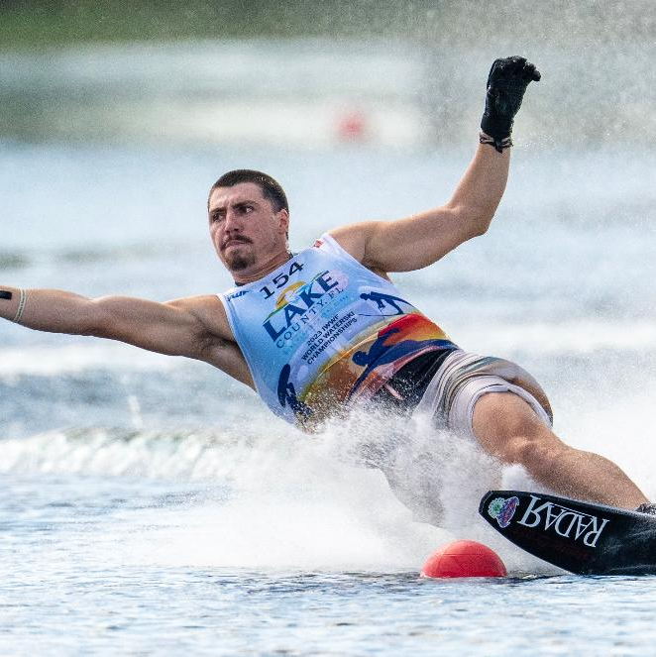
FRIDAY – All together – Beat & Voice & Sound
TIME 14.00 | TOPIC Opening 2025 Seminar - 30th Officials Seminar | Candido & Lukas
14.00 | WORLD RULES & EA ADD. RULES – changes 2025 Waterski, Cableski & Disabled Rules together | Candido, Gavin Elena, Paul, Dany
15.30 - 16.00 | Coffee Break
16.00 | Rules (cont.) + Quiz | Candido, Dimos & Stian
17.30 | EMS for 2025 | Morten & Dany
19.00 – 21.00 | Dinner (local restaurant)

Slide 10
SATURDAY – Before Lunch – All together – Beat & Voice & Sound
Competition Tech Setup/Simulation
09.00 – Slalom
10.30 – Break
10.45 – Tricks
11.45 – Jump
12.30 – 13.30 Lunch

Slide 11
SATURDAY AFTER LUNCH - SPLIT SESSIONS – 4 ROOMS
TIME | ROOM 1 – Beat | ROOM 2 - Voice | ROOM 3 - Sound | ROOM 4 - Meat & Eat
13.30 | Minimum Competition Standards (IWWF 25.09) and E&A Normal Competition Standards (EA4.1.4) - WR vs. RL vs. NH Dimos, Stian | SLALOM & JUMP TECH - practice with system Donal, Ian | SCORING - setup Scoring Software (before comp.) - preparing paperwork (@ site) - setup technical connections - running events - at the end of day - at the end of competition Dany, Hannu, Ulf, Paul | TRICKS (to exam participants) - new Tricks (last 3-5 years) with examples - pre-turns vs. complete turn - judging training Candido, Martin
14.45 | OFFICIALS DUTIES & RESPONSIBILITIES Dimos, Stian | TRICKS TRAINING - eyeTrick - SplashTricks - Stopwatch TRICKS SCORING - training with Judges Candido, Donal, Hannu, Ian | Cableski Disabled | Exams 1 SLALOM PRACTICAL EXAM - J1, J1*, J2, J2* - ONLINE EXAM ONLY - use own computer (PC preferred) Aliaksandra, Council
16.00 – 16.15 | Coffee break

Slide 12
SATURDAY AFTER LUNCH - SPLIT SESSIONS – 4 ROOMS
16.15 | Minimum Competition Standards (IWWF 25.09) and E&A Normal Competition Standards (EA4.1.4) - WR vs. RL vs. NH Dimos, Stian | SLALOM & JUMP TECH - practice with system Donal, Ian | Cableski Disabled | Exams 2 TRICKS PRACTICAL EXAM - J1, J1*, J2, J2* - ONLINE EXAM ONLY - use own computer (PC preferred) Aliaksandra, Council
17.30 | OFFICIALS DUTIES & RESPONSIBILITIES Dimos, Stian | TRICKS TRAINING - practice with systems - eyeTrick - SplashTricks - Stopwatch TRICKS SCORING - training with Judges Candido, Donal, Hannu, Ian | Cableski Disabled | Exams 3 ALL THEORY EXAMS - All Officials and All Levels - ONLINE EXAM ONLY - use own computer (PC preferred) Aliaksandra, Council
20,00 – 23,00 | DINNER @ CITY CENTER - ČERVENÝ JELEN (RED DEER)

Slide 13
SUNDAY – All together – Beat & Voice & Sound
09.00 | SAFE SPORT SAFETY | Gavin & Karen Hannu & Candido
11.00 (closing latest at 12:00) | FEEDBACK NEXT SEMINAR CLOSING 2025 Seminar | Candido Hannu Candido & Lukas

Slide 14
E&A Waterski, Cableski and Disabled Officials seminar 2025
OFFICIALS EXAMS

Slide 15
E&A Waterski, Cableski and Disabled Officials seminar 2025
PANELS FOR TITLED EVENTS

Slide 16

Rules Update
Candido assisted by Gavin

Slide 17
Rule 1.10 IWWF Licence
Rule has been updated but no change to intent
To compete in any IWWF "L", "R" "CP" or Titled event a skier must hold a valid IWWF license. These are available to purchase through the Event Management System (EMS) A skier without a valid IWWF license cannot take part in those competitions.
It is requested that Federations ensure that all their athletes hold a valid IWWF License before participating in "L", "R" "CP" or "Titled event.

Slide 18
Rule 1.11 and 1.12

Slide 19
1.13 Recordings/Transmissions
The recording and transmission of any audio utilised during a competition, either for judging or webcasting which includes the interaction of judges during their official capacity must not be broadcast to the general public nor reproduced for general consumption. The privacy of officials must be safeguarded.
With the explicit permission of the Chief Judge, personal video recording from the trick boat may be allowed. The Chief Judge must consider safety when approving such use. No recording equipment or brackets may be fitted to the boat in any fashion.
The placement of webcast cameras in the Jury Towers must be done in agreement with the Chief Judge.
No other microphone or camera can be placed in the boat or in the Jury Tower.

Slide 20
1.14: Judgement Call
When a judgment decision cannot be made after all allowable reviews, then the decision shall be to the benefit of the skier. This rule is applicable for all Judge’s decisions.

Slide 21
5.06: Boat Added Weight and Manufacturers Equipment
a) Boat Added Weight
If considered necessary to achieve a balanced boat, the Driver with the agreement of the Boat Judge may add a suitable weight to the passenger or driver’s area to even out boat balance, wakes, spray and boat handling. In addition, weight not exceeding 25kg. may be added to the bow of the boat for purposes of levelling the boat. Any added weight shall not present a hazard to the boat occupants or potentially damage the boat’s interior. Once placed the weight shall remain until any change of the boat crew takes place.
Note: no other weight can be added to the boat with the exception reported below and in rule 9.14.

Slide 22
5.11: Skier Supplied Handle in Slalom and Jump
For Slalom and Jump each competitor may furnish his own handle. All skier supplied handles shall be made of a material with a non-slip surface or coating, have no sharp edges or projections, and slalom handle must have protective end caps. The attaching ropes must in all cases go through the handle and must be attached so there is no possibility of movement between the rope and handle when in use. The handle shall be attached to the rope so that it is perpendicular to the direction of the line.
Width shall be between 24cm and 36cm.
The length of the handle measured from the inside surface of the attaching loop furthest from the handle to the inside edge of the handle must be 1.50m (tolerance +2.5cm), length shall be measured using a 2cm block at the inside edge at the handle centre.

Slide 23
5.11: Skier Supplied Handle in Slalom and Jump
• Short length tolerances as noted in 5.09 d) shall not be enforced, in other words a skier supplied handle which measures short per rule 5.09 d) shall not be reason for disqualification.
The handle must be similar in design and construction to picture 1 below.

Slide 24
5.14: Jump Switch
A jump switch is a device connected to the speed control system. The tow line is fed though the switch. When sufficient load is applied to the tow line, the contact switch (normally open) momentarily engages and closes the switch. Engaging the switch results in additional RPM and speed to compensate for skier’s load. The switch should close when a load of 57 kgf (52 – 62kgf) is applied using a 10mm diameter line. The Homologator may (with permission of the owner) adjust jump switch if required to obtain the desired 57 kgf. The skier may request the switch be moved on the tow line to the spice section with a larger diameter (switch engages with less load).

Slide 25
8.08: A Miss or "Riding Over"
a) Skier Turn Buoys. It is a miss to ride inside a turn buoy, or to ride over, straddle, or jump a turn buoy. There is no penalty for grazing a turn buoy with the ski or part of the body. Riding over shall be defined as hitting a turn buoy so as to move it significantly from its position or temporarily sink it. Hitting a turn buoy less severely shall be considered as grazing.
The buoy shall be judged when the front binding is at the buoy.
b) Entrance & Exit Gates. It is a miss to ride outside the entrance or exit gate, but there is no penalty for grazing a gate buoy with the ski or part of the body. A skier shall be judged as missing the entry or exit gate when the centreline of the ski, at the position of the front binding, passes outside the centre of the gate buoy, as illustrated in the diagram below.

Slide 26
8.12: Ties
When a run-off for first place is between more than two skiers, all the places equal to the number of skiers in the run-off are decided by the run-off with no reversion to the preliminary round score except that the preliminary round score would be used if two or more skiers are still tied for 2nd and 3rd places after the run-off.
After the third consecutive run-off, if a tie still exists, the skiers will be offered to tie the position. All the skiers in the run-off must agree.
Skiers tied on score in the final round, not in a medal position, will be listed as tied in the final results.
For preliminary round ties refer to rule 14.09

Slide 27
8.13: Slalom Judging
There is no change to this rule but the diagrams and wording have been simplified

Slide 28
8.15: Boat Path/End Course Video
Buoy Deviation
The Buoy Deviation is the maximum deviation toward the skier measured from when the pylon is at the buoy to 5 metres after the buoy. It is also used to calculate the Cumulative Deviation.
Max Buoy deviation on a single buoy is 25cm.
Note: For any World Record, the max deviation at any single buoy is 20cm. For a deviation greater than 20cm but not greater than 25cm, that score will be recorded for the competition. If a World Record is rejected, the score will be reduced on the rankings list by the IWWF to one increment below the World Record.

Slide 29
8.15: Boat Path/End Course Video
b) Pass completed
If the Buoy Deviation is NEGATIVE (path away from the skier) and is greater than 25cm:
The skier is entitled to an optional re-ride.
The skier can improve.
The maximum score not out of tolerance to the positive is protected.
Continuing at risk (see below).
If the Buoy Deviation is POSITIVE (path towards the skier) and is greater than 25cm:
The skier has the following options:
Accept the score that was achieved within tolerance.
Take a re-ride. The skier can improve over the original score. The score that was achieved within tolerance is protected.
Continuing at risk (see below)

Slide 30
8.15: Boat Path/End Course Video
Cumulative Deviation
a) Pass not completed
If the Cumulative Deviation is NEGATIVE out of tolerance (away from the skier)
The skier is entitled to an optional re-ride.
The skier can improve.
The maximum score not out of tolerance to the positive is protected.
If the Cumulative Deviation is POSITIVE out of tolerance (toward the skier)
The skier has the following options:
Accept the score that was achieved within tolerance.
Take a re-ride. The skier cannot improve over the original score. The score that was achieved within tolerance is protected.

Slide 31
8.15: Boat Path/End Course Video
Cumulative Deviation
b) Pass completed
If the Cumulative Deviation is NEGATIVE out of tolerance (away from the skier)
The skier is entitled to an optional re-ride.
The skier can improve.
The maximum score not out of tolerance to the positive is protected.
Continuing at risk (see below).
If the Cumulative Deviation is POSITIVE out of tolerance (toward the skier)
The skier has the following options:
The skier can accept the score that was achieved within tolerance.
The skier can take a re-ride. The skier can improve over the original score. The score that was achieved within tolerance is protected.
Continuing at risk (see below)

Slide 32
8.15: Boat Path/End Course Video
Re-rides
There shall be no more than two re-rides for positive boat path deviation in a single pass. If during the second re-ride the boat deviation would require another re-ride for positive boat path deviation, then the score awarded will be the highest score achieved in tolerance from the original pass or from either re-ride. The driver shall be warned that the driving is not acceptable, and that he may be replaced.

Slide 33
Rule 9.15 & 12.07 Trick Re-Rides
Re-rides must be taken in the same direction of the original pass.
For a run-off the skiers cannot choose the direction of the pass. Both will start from the dock.

Slide 34
10.05: Jump Speeds and Ramp Height (55+ MEN)

Slide 35
10.06: Boat Timing and Re-ride Situations
If the jump switch does not engage due to the skiers’ lack of effort and not from switch failure, the jump shall be re-categorised as RTB from Fast.

Slide 36
10.11: Jump Boat Path
The skier…………….
Path Definition
“SPLIT” is boat path between the 15 metre and the 19 metre timing buoys (the COURSE).
Split = Default (Centre 17 metre line)
Split +/- 1 = Split +/- 0.3 metre or 1 foot
Split +/- 2 = Split +/- 0.6 metre or 2 feet
Split +/- 3 = Split +/- 0.9 metre or 3 feet
Skier options are “Split” with +1, +2, +3 for wide or -1, -2, -3 for narrow.
“INSIDE” is defined as boat path between the RAMP and 15 metre timing buoys. Boat Path Measurement is not required for any INSIDE path request.

Slide 37
10.11: Jump Boat Path
Boat Path Measurement System
A Boat Path Measurement System, (BPMS) is required for all Record Capability(R), and Rankings Lists(L) events. All jump passes shall be monitored for PATH, CUT, FLIGHT and CUMULATIVE deviation.
Data will be collected via WaterSkiConnect during the 2025 ski year. Deviation tolerances and re-ride situations will be established for the 2026 ski year for distance …………

Slide 38
10.11: Jump Boat Path
As a guideline, the following is what we are aiming for:

Slide 39
10.11: Jump Boat Path
Boat Path Measurement System
A Boat Path Measurement System, (BPMS) is required for all Record Capability(R), and Rankings Lists(L) events. All jump passes shall be monitored for PATH, CUT, FLIGHT and CUMULATIVE deviation. PATH and CUT tolerances shall be applied for all Open Men and Open Women events, and for all other divisions when the distance is equal to or greater than:
Record Capability(R) and Rankings Lists(L)
50 metres and greater distances.
Titled Events (World or Confederation)
40 metre and greater distances.

Slide 40
10.11: Jump Boat Path
CUT
The CUT Deviation is measured at the pylon when the boat is between 15/19 NT (52m) and 15/19 MT. The CUT calculation is the difference between the values at NT and MT. NT being the point where the jumper is in a glide ready to turn and cut to the ramp. MT being the point where the skier approximately leaves the ramp.
Example: NT is -5cm and MT is +25cm, the difference is a +30cm swing. A positive number would indicate the boat moved away from the ramp. A negative number would indicate that the boat moved towards the ramp during the skiers cut.
If the CUT Deviation is NEGATIVE (towards the ramp) and is greater than 10 cm, the skier is entitled to an optional re-ride with a protected score.
If the CUT Deviation is POSITIVE (away from the ramp) and is greater than 45 cm, then mandatory re-ride. No protected score. Max number of re-rides 2.

Slide 41
11.01: Rules for U-10, U-14, 65+ and over Individual Overall
Qualification for Individual Overall Scoring
a) To qualify for overall, an Under 10 competitor must ski in slalom and tricks. (competing in jump is not necessary)
b) To qualify for overall, an Under 14 competitor must ski in slalom, tricks and jump.
c) To qualify for overall in the 65+ and over age Divisions, competitors must ski in slalom and tricks. (competing in jump is not necessary).

Slide 42
13.08: Collected Money for Video Challenge and Protests
For Titled events any money collected will be distributed between the Officials to help with the travel expenses. For all other events, the collected money will go to the Organiser.

Slide 43
Rule 14.12: Entry and Administration
Each Federation shall declare, through EMS, not later than 75 days before the scheduled start of the first event of the Championships:
The names of the members of its team
The names of the competitors entered as “Individuals”
The names of the competitors entered as Wild Cards
The names of the Official reserves.
For each competitor registered, the events that they will compete in together with the ramp height for Jump need to be entered.
An entry is considered complete when the Skier’s name is registered in EMS and the full Entry Fee Payment has been received.
All payments need to be made by Credit Card/PayPal through EMS. For the Official Reserves, no payment is due at this time.
Any skier entered as a Wild Card or Individual is also to be considered to be a TEAM reserve.
An entered skier may be replaced by a different one without penalty, provided that they have already been entered as a Reserve skier, wild card or individual.
The 75 days deadline does not include those skiers who may additionally qualify as individuals through the Weekly or the Pro Ranking List (If applicable). For those skiers the following deadlines apply:

Slide 44
Rule 14.12: Entry and Administration
a) Fines for Late Registration.
Any Federation not meeting the registration deadlines will not be allowed to compete until their Federation pays a fine to the IWWF Representative at the Championships. The fines are as follows:
* US$25 per skier if the registration is made between 74 and 60 days before the scheduled start of the first event of the Championships
* US$50 per skier if the registration is made between 59 and 45 days before the scheduled start of the first event of the Championships
* US$75 per skier if the registration is made between 44 to 30 days before the scheduled start of the first event of the Championships
* US$100 per skier if the registration is made between 29 to 15 days before the scheduled start of the first event of the Championships
* Double the Entry Fee per skier if the registration is made between 14 days until 12:00 (competition local time), 2 days before the scheduled start of the first event of the Championships

Slide 45
18.04: Overall and Team Competition
To qualify for overall in the 65+ and over age Divisions, competitors must ski in slalom and tricks. (competing in jump is not necessary).

Slide 46
The following will be implemented in 2026 after the new EMS Ranking List has had the necessary changes made to include these situations
If a skier competes in a different age division:
• Slalom scores at 58, 55, 52 or 49 will be equal to a score at any slower speed of 55, 52, 49 or 46.
• Trick scores will be accepted as they are.
• A Jump score executed in a different age division from the athlete's own, can only be used in the skiers age-division ranking list, if performed with a ramp height and speed appropriate to the athlete's age division.
If not, the score will only be valid for the U-21 and Open age divisions.
Rule 24 – World Ranking List

Slide 47
25.09: Minimum Competition Standards
 | World Record “R” | Ranking List “L”
Prior Announcement | YES (refer to *1) | YES
Confederation Approved Panel | YES | YES
Number of Rounds | 4 | 4
Conflict of Interest Rules | Refer to (3.04) | Refer to (3.04)
Chief Judge | “J1” or “J2” | “J1” or “J2”
Homologator | “H1” or “H2” | “H1” or “H2”
Chief Scorer | “S1” or “S2” | “S1” or “S2” or “S3”
Chief Driver | “D1” or “D2” | “D1” or “D2” or “D3”
Appointed Judges Minimum 3 (refer to *4) | “J1” or “J2” | “J1”, “J2” or J3 Majority of the Appointed Judges must be “J1” or “J2”
Duplication of duty | Any combination of two of the following positions may be held without conflict: Chief Judge/Driver/Scorer/Homologator/Judge (refer to *3)

Slide 48
25.09: Minimum Competition Standards
*3 Duplication of duties: (Chief Judge, Chief Scorer/Scorer, Homologator and Chief Driver/Driver)
Any duplication of duties is limited to two functions but should be avoided if possible.
Where duplication causes a conflict, the final decision will be made by a simple majority of the Event Judges.
In any case of duplication of duty, the Official must have the required rating.
Allowed duplication of duty
A Driver cannot have more than two roles except tricks, where the driver may be the boat judge

Slide 49
25.09: Minimum Competition Standards
*4 Appointed Judges
The following rules are the responsibility of the Appointed Judges:
1.02: Exceptions to the Rules
1.03: Interpretation of the Rules
1.07: Unsportsmanlike Conduct
3.04: Officials Conflicts of Interest
3.05: Voting of the Judges
13.01: Who may Protest and How it is done
14.10: Schedule Changes
14.16: Scoring
19.03: Who may Protest and How it is Done
For the purpose of dealing with these rules the Event Judges of each event will also be considered to be Appointed Judges, except for Title Events, where all the Judges appointed by the WSC are the Appointed Judges.

Slide 50

Europe & Africa Additional Rules

Slide 51
Europe & Africa Additional Rules
There are few changes to the Additional Rules except alignment to the new Competition Entry rules using EMS where the deadline dates have changed.

Slide 52
14.12: Entry and Administration
Each Federation shall declare, through EMS, not later than 60 days before the scheduled start of the first event of the Championships:
The names of the members of its team
The names of the competitors entered as “Individuals”
The names of the competitors entered as Wild Cards
The names of the Official reserves.
For each competitor registered, the events that they will compete in together with the ramp height for Jump need to be entered.
An entry is considered complete when the Skier’s name is registered in EMS and the full Entry Fee Payment has been received.
All payments need to be made by Credit Card/PayPal through EMS. For the Official Reserves, no payment is due at this time.

Slide 53
Any skier entered as a Wild Card or Individual is also to be considered to be a TEAM reserve.
An entered skier may be replaced by a different one without penalty, provided that they have already been entered as a Reserve skier, wild card or individual.

Slide 54
The 60 days deadline does not include those skiers who may additionally qualify as individuals through the Weekly or the Pro Ranking List (If applicable). For those skiers the following deadlines apply:
1) The deadline to enter skiers who qualify under the Weekly Ranking List is 30 days before the Championships.
2) The deadline to enter skiers who qualify under the Pro Tour Ranking List is 15 days before the Championships.

Slide 55
25.09: Minimum Competition Standards
*3 Duplication of duties: (Chief Judge, Chief Scorer/Scorer, Homologator and Chief Driver/Driver)
In E&A, for Record Capability events, only the following duplication of duty are allowed:
Chief Judge and Judge
Chief Scorer/Scorer and Homologator.
Chief Scorer/Scorer and Judge.
Homologator and Judge.
Chief Driver/Driver and Judge*
* The Chief Driver/Driver cannot have 2 roles in the Division/Event he is acting as a driver (excluding Tricks where he can be the Driver and the boat Judge).

Slide 56
EA5.1.06: Examinations
a) Exams can be taken at the European Officials Seminar, at a National Seminar and/or National Championships (provided the lecture/examiner is approved by the WSC), at a Waterski Council meeting and any Titled Event.

Slide 57
EA5.4 – Level 2 Judges (J2 – J2*)
EA5.4.03: Theoretical Examination
a) The examination tests that the candidate can master the application and interpretation of the rules to the level necessary to judge at R homologation competitions.
b) The questions are written in English. No translation into any other language is provided.
c) The pass mark is 80%.
EA5.4.04: Practical Examination
The examination is in two parts:
a) A test of advanced trick calling and judging.
The trick call will be from a special video compiled by the WSC.
Points will be rewarded for calling and judging the tricks performed.
The pass mark is 80%.

Slide 58
EA5.10 – Level 1 Drivers (D1)
EA5.10.04: Practical Experience
The practical examination has been replaced by a mandatory evaluation utilising the driving data stored in the driver’s portal.
Evaluating process: Data will be taken from 3 competitions (communicated by the candidate), with at least 10 skiers each and with the following minimum score:
Slalom: 2@10.75 - Jump: 55m - Tricks: 7000 pts

Slide 59
Slalom
Boat Path: No single buoy deviation more than ± 20cm from center
Boat Path – Cumulative: No single pass out of tolerance
Driving: Perfect alignment at pre-gate and entry gate. (95% of passes)
d) Other Factors:
1. Knowledge of Zero Off / Map slalom course
2. Knowledge of SurePath Set up and use
3. Ease and precision of making necessary changes between skiers at the dock.
4. Boat path - alignment before entering course - how far ahead and how consistent.
5. End of course - precision and consistency in dropping the skier, starting, and turning.
6. Attention to safety at all times.
7. Knowledge of slalom/tricks/Jump rules and related driver duties.

Slide 62
EA5.11 – Level 2 Drivers (D2)
For L2 the examination criteria is the same as level 1 but with more relaxed tolerances

Slide 63
EA5.13.07: List of National Officials
Each Federation is responsible for reviewing and updating its own Level 3 Officials in the EMS, at the beginning of each season and to keep data updated.

Slide 64
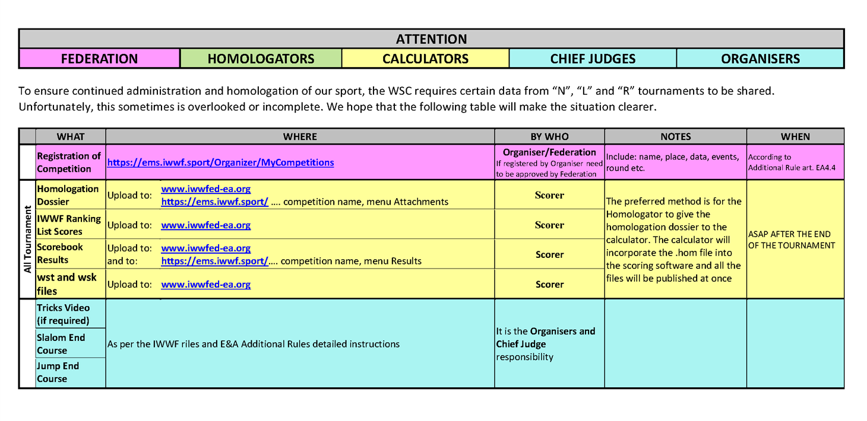

Slide 65
EA5.13.06: Examinations
The WSC launched a series of online exam papers for level 3 Officials which are available for National Federations to use for a 100 euro annual fee. National Federations are not obliged to use these exams and can continue to use their own. However, their use will help achieve a common standard.

Slide 66
And now Disabled and Cableski can comment on their Rules for 2025 if any significant changes

Slide 67
THE QUIZ
Have you been paying attention?

Slide 68
Thank you
EMS – Morten & Dany

