Slide 1
Organising a Competition
Prague 2025

Slide 2
Info
Guidelines and requirements for organizing competitions
Ranking list homologated competitions vs Normal homologated competitions
Specific requirements for Normal homologated competitions

Slide 3
HOMOLOGATION LEVEL DIFFERENCES
Level on skiers
Officials
Technical equipment
Jump measurement?
Trick timing?
Trick judging?
Gate video?
End course video?
Tolerances
Safety

Slide 5
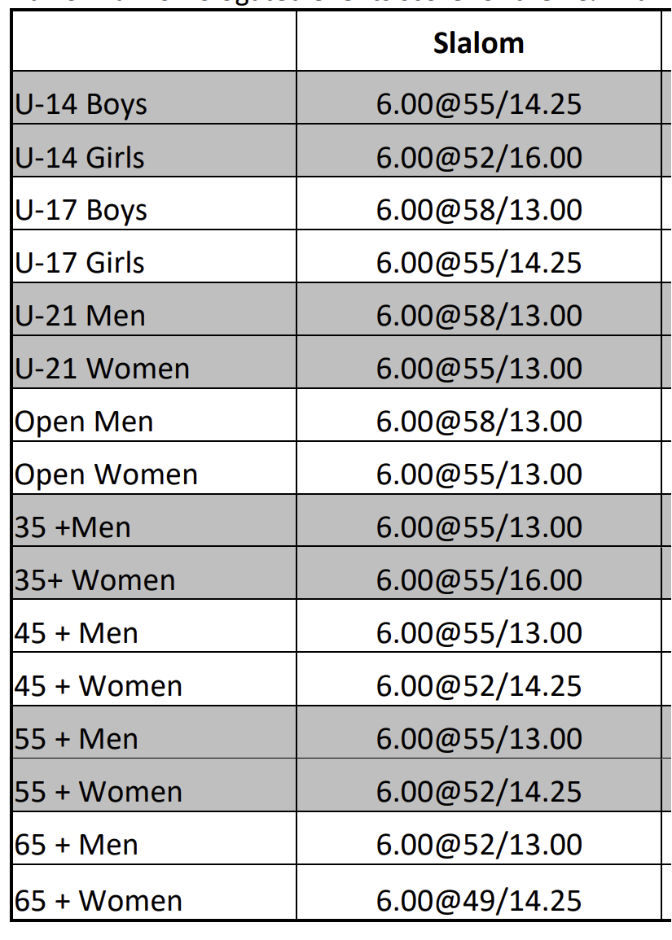
NORMAL HOMOLOGATION COMPETITION
Ranking list results:
Slalom score?

Slide 6
NORMAL HOMOLOGATION COMPETITION
Ranking list results:
JUMP score?

Slide 7
NORMAL HOMOLOGATION COMPETITION
Ranking list results:
TRICK score?

Slide 8
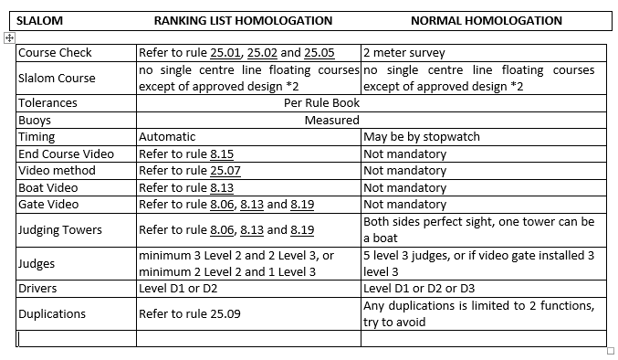
RANKING vs NORMAL SLALOM

Slide 9
RANKING vs NORMAL TRICKS

Slide 10
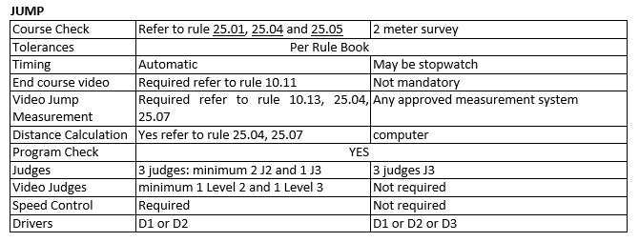
RANKING vs NORMAL JUMP

Slide 11
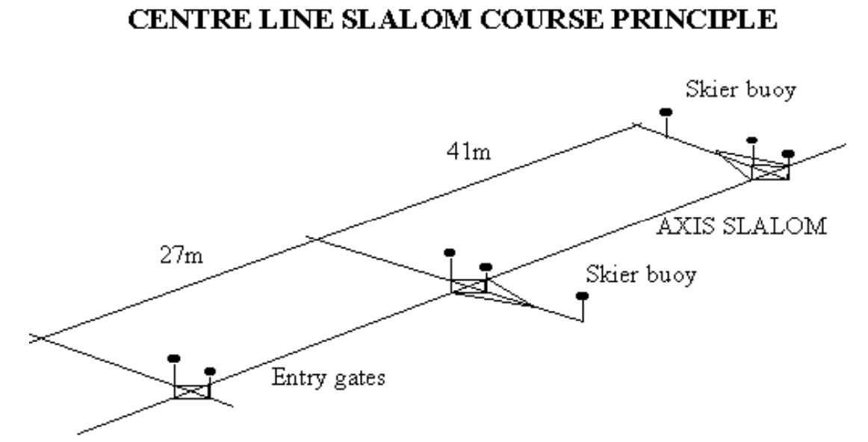
HOMOLOGATION LEVEL DIFFERENCES
All tolerances are easier to achieve in Normal homologation surveys.
Example: Length from center axes to skiers bouy.

Slide 12
What skiers want
Skiers want to have their scores registered
To achieve this, they need to attend a minimum of 2 homologated competitions per year.
The level of homologation might limit the score for the highest ranked skiers but will not affect 70% of the skiers.

Slide 13
BENEFITS
Normal homologation will fulfil the needs of most of your skiers.
Easier to organize:
Can be registered 2 weeks before the event
Less officials
Less equipment
Lower overall cost
Lower homologation fee
Lower entry fee?
More skiers would appear in the Ranking list

Slide 14
SAFETY
Safety should never change, no matter the level of competition.
This includes non homologated and/or registered competitions.

Slide 15
Questions???

