Slide 1
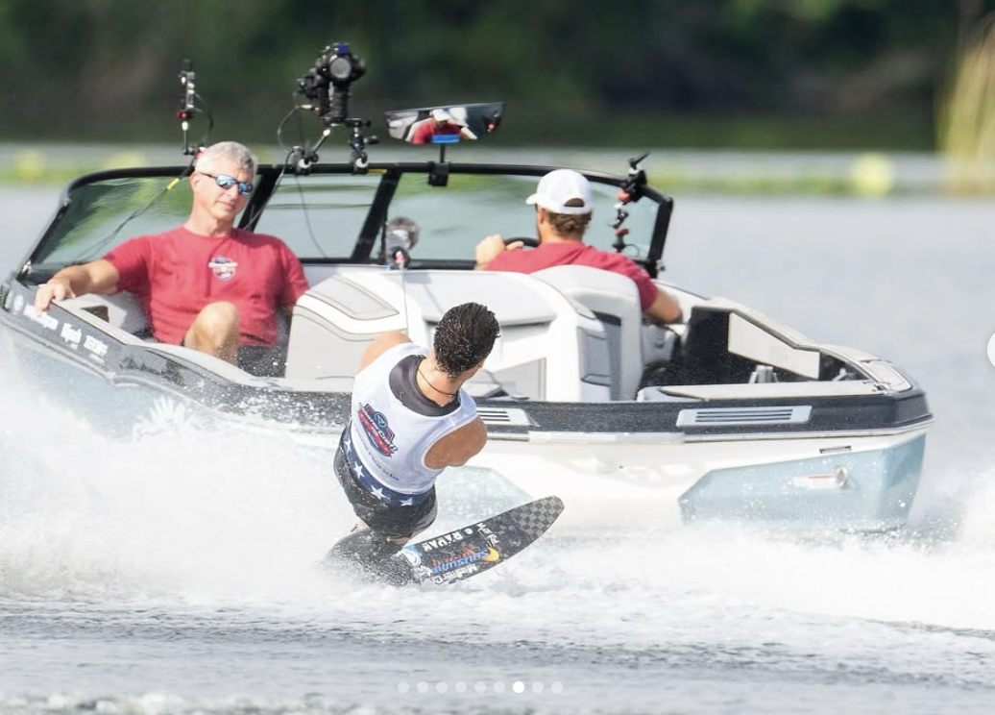
SafeGuarding & the IWWF

Slide 2
Whether you are an athlete, a coach, an official, or simply someone passionate about sport, we all share a common responsibility: ensuring that sport is a safe, supportive,
and positive environment for everyone involved.

Slide 3
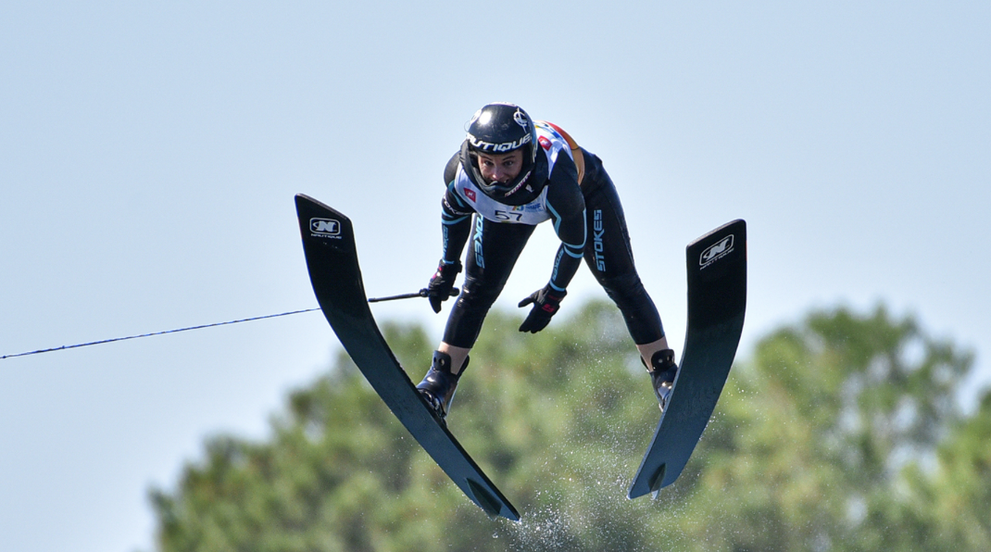
The Pillars of Safe Sport
Sport has the power to transform lives. It builds confidence, promotes teamwork, and encourages a healthy lifestyle. However, for sport to have its full positive impact, it must be a space where everyone feels safe—physically, emotionally, and psychologically.

Slide 4
Safeguarding in sport means protecting athletes from harm, abuse, neglect, and exploitation. It ensures that sport remains a place of respect, inclusion, and enjoyment for all. Without effective safeguarding measures, the very environment meant to empower individuals can instead become one of fear, mistreatment, and lost potential.

Slide 5
No matter how subtle or obvious the signs may be, they must never be ignored…

Slide 6
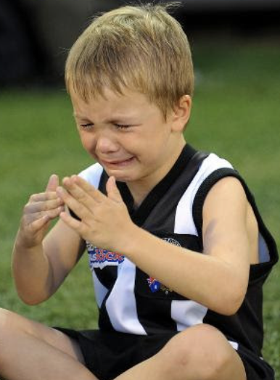
Different Forms of Abuse
Physical Abuse: Unexplained bruises, injuries, or reluctance to participate in training.
Emotional Abuse: Signs of fear, anxiety, or low self-esteem, particularly in relation to interactions with a coach, teammate, or official.
Sexual Abuse or Harassment: Inappropriate comments, unwanted physical contact, or secretive behaviour between an athlete and an authority figure.
Neglect: Lack of proper nutrition, rest, or medical care, as well as being forced to train through injury or illness.
Bullying or Harassment: Intimidation, exclusion, or repeated negative comments from peers, coaches, or officials.

Slide 7
What do you do if you have
Safeguarding Concerns?

Slide 8
What to Do
If you suspect safeguarding concerns, action must be taken.
Listen & Support: If someone confides in you about abuse or misconduct, listen
carefully, believe them, and offer reassurance.
Report Concerns: Whether you witness or suspect something, report it to the appropriate safeguarding
officer, governing body, or relevant authority. Silence enables harm.
Follow Protocols: Every club, team, or organization should have safeguarding policies in place.
Make sure you are familiar with these procedures and follow them diligently.
Educate yourself and Others: Regular training and awareness programs help
ensure that safeguarding remains a priority in all sports settings.
Lead by Example: Coaches, officials, and senior athletes have the power to set a
positive culture. Foster an environment of respect, fairness, and open
communication.

Slide 9
A Collective Effort
Safeguarding is not the job of one person or one organization—it is a collective effort.
By working together, we can create a culture where athletes of all ages, backgrounds, and abilities feel safe and valued.

Slide 10
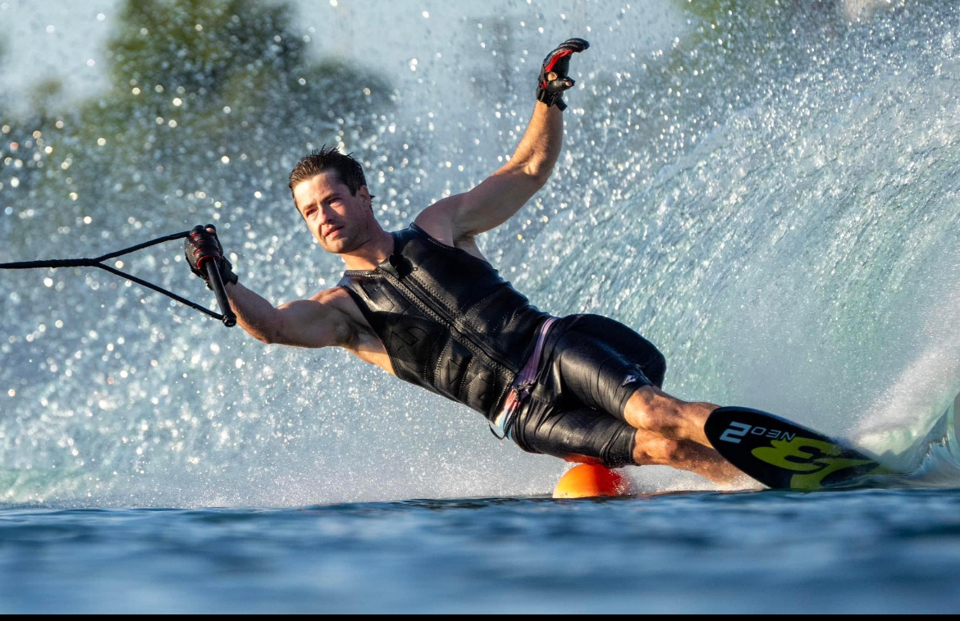
Let’s commit to making sport a place where individuals are empowered, where their voices are heard, and where their well-being is protected. Because only in a safe environment can athletes truly thrive, perform at their best, and enjoy the lifelong benefits of sport.

Slide 11
Iwwf.Sport
Safe Sport Policy

